Slide 1


RIM-Based Relational Database Design
Stepwise Refinement and Transformation Design Process
Abdul-Malik Shakir
Principal Consultant, Shakir Consulting
Presented to:
The University of Texas M. D. Anderson Cancer Center
Houston, Texas
March 31, 2009
Session 4 of 4

Slide 2
About Me
Abdul-Malik Shakir
Information Management Strategist
City of Hope National Medical Center, Duarte, CA
Since December 2008
Member of Health Level Seven since 1991
  Co-Chair of the HL7 Education Workgroup
  Active member of:
    Architectural Review Board (ArB)
    Public Health and Emergency Response Workgroup (PHER)
    Regulated Clinical Research Information Management Workgroup (RCRIM)
    Modeling and Methodology Workgroup (MnM)
    RIM-Based Application Architecture Workgroup (RIMBAA)
Principal Consultant for Shakir Consulting since 2001
Senior Technical Architecture Advisor for Cal2Cal Corporation assisting the
Los Angeles County Public Health Department since 2005
UML Modeling Facilitator for Clinical Data Interchange Standards Consortium (CDISC) since 2008
BRIDG Model Harmonization Facilitator for International Institute for Safety in Medicine (II4SM) since 2008
March 2008
HL7 RIM-Based Database Design
<number> of 115

Slide 3
Two Day Tutorial Agenda
Session 1 Healthcare Informatics Standards & Interoperability | Session 3 Design Level Static Information Models
Session 2 Domain Analysis Modeling | Session 4 RIM-Based Relational Database Design
Monday
Tuesday
March 2008
HL7 RIM-Based Database Design
<number> of 115

Slide 4
Session Outline
Session Overview
  Focus and Premises
  Definitions and Axioms
HL7 V3 Reference Models
  Reference Information Model
  Datatype Specification
  Structural Vocabulary
Database Design Steps
  Subset Data Model
  Logical Data Model
  Physical Data Model
Questions and Discussion
Characteristics of a Useful Model
March 2008
HL7 RIM-Based Database Design
<number> of 116

Slide 5
Session Overview – Focus and Premises
The objective of this tutorial is to present solutions to the set of issues to be considered when designing a relational database structure based upon the HL7 Reference Information Model.
The tutorial is primarily focused on the design process.
The resulting example models and model fragments are merely examples and represent just one of many possible, equally valid designs.
The premise behind this tutorial is that the relational database design effort is driven by application requirements and technical architecture constraints.
A second premise behind the tutorial is that “all models are wrong, but some models are useful”.
A useful relational database design model is one that fulfills predetermined application requirements and technical architecture constraints.
March 2008
HL7 RIM-Based Database Design
<number> of 115

Slide 6
Session Overview – Definitions and Axioms
A RIM-Based model is an information model whose content and structure is a conformant constrained view of the RIM.
A RIM conformant model is an information model whose semantics do not contradict the semantics of the RIM.
Models that are structurally different can still be semantically similar so that the semantics of one is not contradicted by the other.
A RIM constrained model is an information model whose semantics do not extend the semantics of the RIM.
The RIM may be constrained by three primary means: model element exclusion, datatype specialization, and vocabulary binding.
March 2008
HL7 RIM-Based Database Design
<number> of 115

Slide 7
Structural Variance and Semantic Consistency
Model One
Person
«datatype»
-
name: PersonName
PersonName
-
birthDate: dateTime
-
lastName: char
-
phone: PersonPhone [0..2] (list)
-
firstName: char
Person
constraints
Model Two
-
lastName: char
{PersonPhone(1) is Home Phone}
-
firstName: char
{PersonPhone(2) is Work Phone}
-
birthDate: dateTime
-
homePhone: char
«enumeration»
-
workPhone: char
«datatype»
PhoneKind
PersonPhone
«enum»
-
phoneKind: PhoneKind
Home
-
phoneText: char
Work
PersonName
Person
-
personNameKind: PersonNameKind
-
birthDate: dateTime
0..2
-
personNameText: char
constraints
{PersonNameKind is Unique}
Model Three
0..2
PersonPhone
«enumeration»
«enumeration»
-
phoneKind: PersonPhoneKind
PersonPhoneKind
PersonNameKind
-
phoneText: char
«enum»
«enum»
constraints
Home
lastName
{PersonPhoneKind is Unique}
Work
firstName
March 2008
HL7 RIM-Based Database Design
<number> of 115

Slide 8
Database Design Modeling Steps
Select a Subset of RIM Model Elements
Resolve Inheritance Anomalies
Specialize Attribute Datatypes
Resolve Collection Datatypes
Resolve Complex Datatypes
Transform Classes into Tables
Define Data Integrity Rules
Assign Primary, Foreign, and Alternate Keys
Optimize the Database Design Model
Generate Database Definition Language
Document Departures from the RIM
March 2008
HL7 RIM-Based Database Design
<number> of 115

Slide 9
HL7 Version 3.0
Reference Models
The HL7 Reference Models (RIM, Datatype, and Vocabulary) are the foundation of the HL7 Version 3.0 development methodology and specifications. All HL7 v3 specifications (messages, documents, and services) are a refinement and constrained view of these foundational models.
March 2008
HL7 RIM-Based Database Design
<number> of 115

Slide 10
HL7 v3.0 Reference Models
Reference Models
Reference
Information
Model
The HL7 Reference Information Model is the information model from which all other information models and message specifications are derived.
Datatype
Specification
The HL7 Datatype Specification defines the structural format of the data carried in an attribute and influences the set of allowable values an attribute may assume.
Vocabulary
Specification
The HL7 Vocabulary Specification defines the set of all concepts that can be taken as valid values in an instance of a coded attribute or message element.
March 2008
HL7 RIM-Based Database Design
<number> of 115

Slide 11
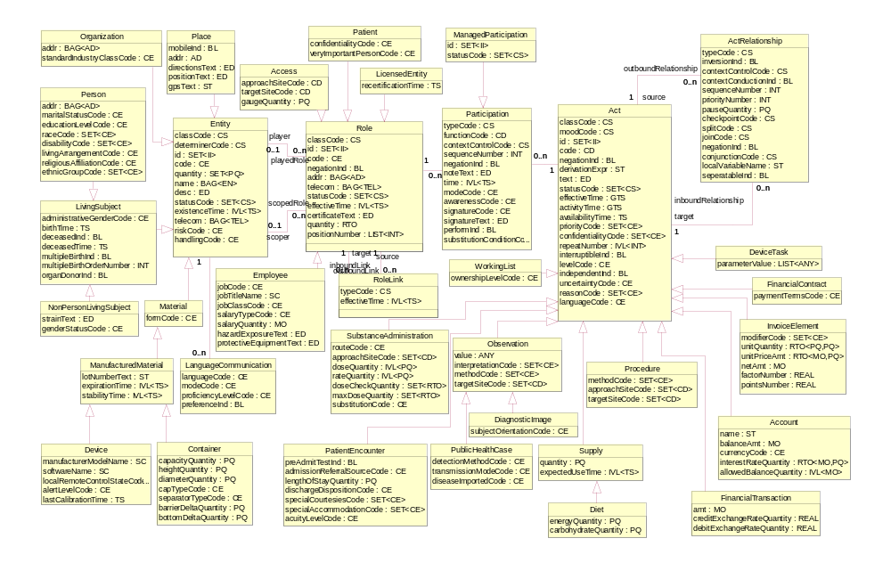
HL7 RIM Class Diagram
March 2008
HL7 RIM-Based Database Design
<number> of 115

Slide 12
RIM Core Classes
Entity - a physical thing or an organization/group of physical things capable of participating in Acts. This includes living subjects, organizations, material, and places.
Act – a discernible action of interest in the healthcare domain. An instance of Act is a record of that action. Acts definitions (master files), orders, plans, and performance records (events) are all represented by an instance of Act.
Entity
Act
class_cd : CS
cd: CE
determiner_cd : CS
status_cd : CS
id : II
class_cd : CS
cd: CD
mood_cd : CS
status_cd : CS
effective_time : GTS
id : II
0..*
0..*
March 2008
HL7 RIM-Based Database Design
<number> of 115

Slide 13
RIM Core Classes
Entity
Role
Act
class_cd : CS
cd: CE
determiner_cd : CS
status_cd : CS
id : II
class_cd : CS
cd: CE
effective_time : IVL<TS>
status_cd : CS
id : II
class_cd : CS
cd: CD
mood_cd : CS
status_cd : CS
effective_time : GTS
id : II
1
plays
0..*
0..*
0..*
March 2008
HL7 RIM-Based Database Design
<number> of 115

Slide 14
RIM Core Classes
Role – a classification/specialization of an Entity defined by the relationship of the playing Entity to a scoping Entity. An example of Role is “Employee”. An employee is a classification attributed to a person which has an employment relationship with an organization (Employer).
Entity
Role
Act
class_cd : CS
cd: CE
determiner_cd : CS
status_cd : CS
id : II
0..1
plays
class_cd : CS
cd: CE
effective_time : IVL<TS>
status_cd : CS
id : II
class_cd : CS
cd: CD
mood_cd : CS
status_cd : CS
effective_time : GTS
id : II
0..*
0..*
0..*
0..1
scopes
0..*
March 2008
HL7 RIM-Based Database Design
<number> of 115

Slide 15
RIM Core Classes
Participation – an association between a Role and an Act representing the function assumed by the Role within the context of the Act. A single Role may participate in multiple Acts and a single Act may have multiple participating Roles. A single Participation is always an association between a particular Role and a particular Act.
Entity
Role
Participation
Act
class_cd : CS
cd: CE
determiner_cd : CS
status_cd : CS
id : II
0..1
plays
class_cd : CS
cd: CE
effective_time : IVL<TS>
status_cd : CS
id : II
type_cd : CS
time : IVL<TS>
status_cd : CS
class_cd : CS
cd: CD
mood_cd : CS
status_cd : CS
effective_time : GTS
id : II
0..*
1
1
0..*
0..*
0..1
scopes
0..*
March 2008
HL7 RIM-Based Database Design
<number> of 115

Slide 16
RIM Core Classes
Act relationship – an association between two Acts. This includes Act to Act associations such as collector/component, predecessor/successor, and cause/outcome. The semantics of the association is captured by the Act Relationship attributes.
Act Relationship
type_cd : CS
0..*
0..*
1
1
Entity
Role
Participation
Act
class_cd : CS
cd: CE
determiner_cd : CS
status_cd : CS
id : II
0..1
plays
class_cd : CS
cd: CE
effective_time : IVL<TS>
status_cd : CS
id : II
type_cd : CS
time : IVL<TS>
status_cd : CS
class_cd : CS
cd: CD
mood_cd : CS
status_cd : CS
effective_time : GTS
id : II
0..*
1
1
0..*
0..*
0..1
scopes
0..*
March 2008
HL7 RIM-Based Database Design
<number> of 115

Slide 17
RIM Core Classes
Role Link – An association between two Roles. It is used to capture relationships that exists between Entities other than the scoping relationships. A
single Role may have a Role Link with multiple other Roles. A single Role Link is always between two distinct instances of Role.
Role Link
Act Relationship
type_cd : CS
effective_time : IVL<TS>
type_cd : CS
0..*
0..*
0..*
0..*
1
1
1
1
Entity
Role
Participation
Act
class_cd : CS
cd: CE
determiner_cd : CS
status_cd : CS
id : II
0..1
plays
class_cd : CS
cd: CE
effective_time : IVL<TS>
status_cd : CS
id : II
type_cd : CS
time : IVL<TS>
status_cd : CS
class_cd : CS
cd: CD
mood_cd : CS
status_cd : CS
effective_time : GTS
id : II
0..*
1
1
0..*
0..*
0..1
scopes
0..*
March 2008
HL7 RIM-Based Database Design
<number> of 115

Slide 18
Definition of RIM Core Classes
Act – a discernible action of interest in the healthcare domain. An instance of Act is a record of that action. Acts definitions (master files), orders, plans, and performance records (events) are all represented by an instance of Act.
Act relationship – an association between two Acts. This includes Act to Act associations such as collector/component, predecessor/successor, and cause/outcome. The semantics of the association is captured by the Act Relationship attributes.
Entity - a physical thing or an organization/group of physical things capable of participating in Acts. This includes living subjects, organizations, material, and places.
Participation – an association between a Role and an Act representing the function assumed by the Role within the context of the Act. A single Role may participate in multiple Acts and a single Act may have multiple participating Roles. A single Participation is always an association between a particular Role and a particular Act.
Role – a classification/specialization of an Entity defined by the relationship of the playing Entity to a scoping Entity. An example of Role is “Employee”. An employee is a classification attributed to a person which has an employment relationship with an organization (Employer).
Role Link – An association between two Roles. It is used to capture relationships that exists between Entities other than the scoping relationships. A single Role may have a Role Link with multiple other Roles. A single Role Link is always between two distinct instances of Role.
March 2008
HL7 RIM-Based Database Design
<number> of 115

Slide 19
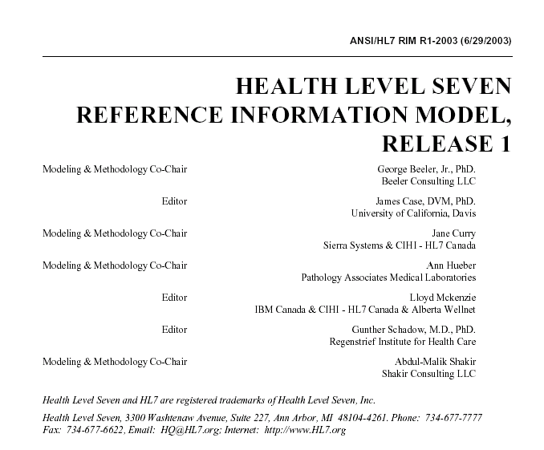
HL7 RIM Normative Specification
March 2008
HL7 RIM-Based Database Design
<number> of 115

Slide 20
HL7 Version 3.0
Data Type Specification
The HL7 Datatype Specification defines the structural format of the data carried in an attribute and influences the set of allowable values an attribute may assume.
March 2008
HL7 RIM-Based Database Design
<number> of 115

Slide 21
HL7 Version 3.0 Data Types
HL7 data types define the structure and constrain the allowable values of attributes in the RIM.
The HL7 data type specification declares the set of data types, identifies components of complex types, and defines relationships between data types.
The HL7 data type implementation technology specification defines constraints and operations for data types and describes how data types are to be represented in XML.
Data types are reusable atomic building blocks used to create all HL7 V3 information structures.
Each RIM attribute is assigned one data type; each data type is assigned to zero, one, or more RIM attribute.
March 2008
HL7 RIM-Based Database Design
<number> of 115

Slide 22
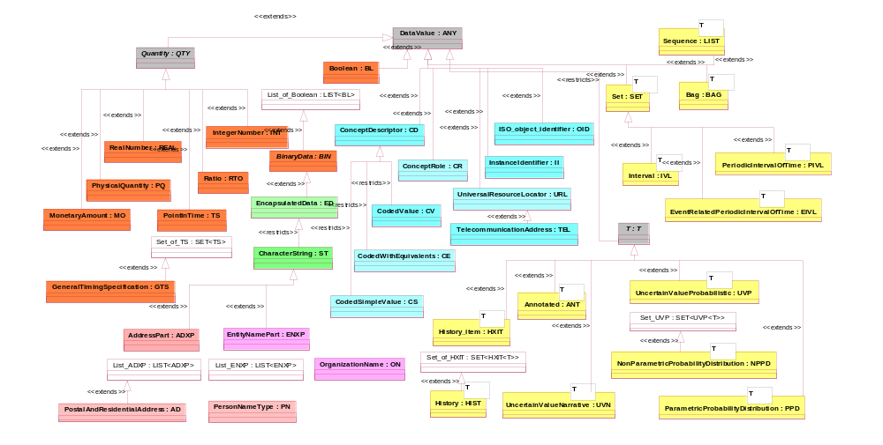
Datatype Class Diagram
March 2008
HL7 RIM-Based Database Design
<number> of 115

Slide 23
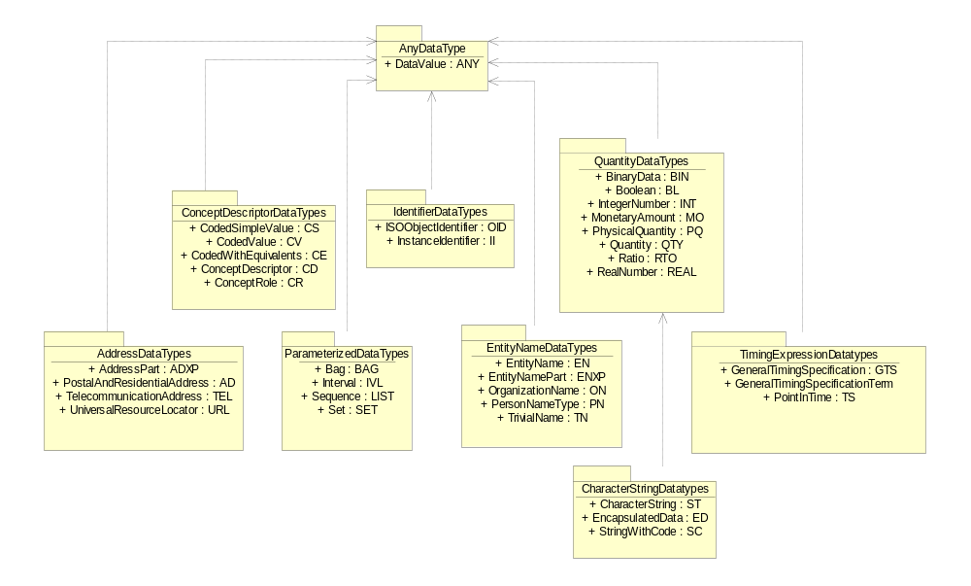
HL7 Data Type Packages
March 2008
HL7 RIM-Based Database Design
<number> of 115

Slide 24
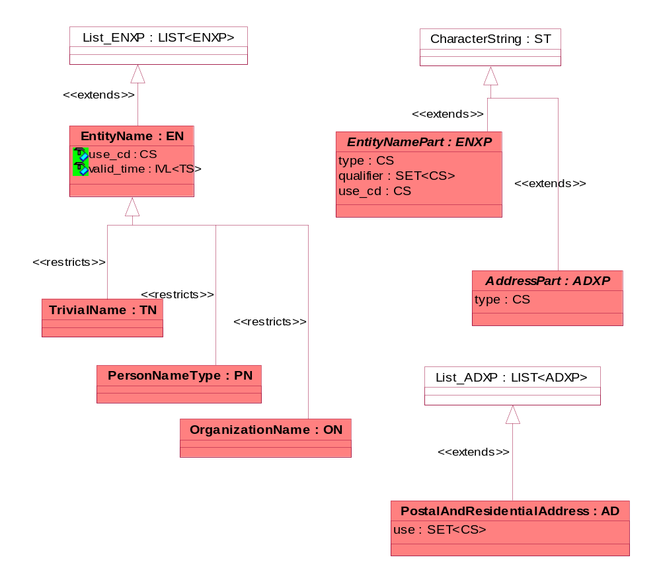
Demographic Datatypes
March 2008
HL7 RIM-Based Database Design
<number> of 115

Slide 25
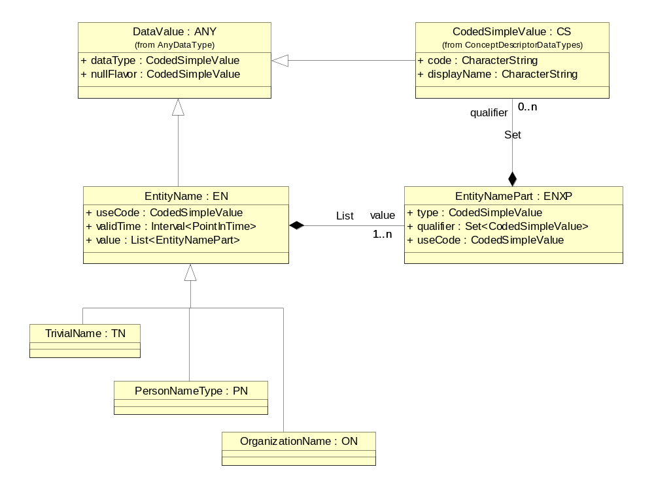
Entity Name Data Types
March 2008
HL7 RIM-Based Database Design
<number> of 115

Slide 26
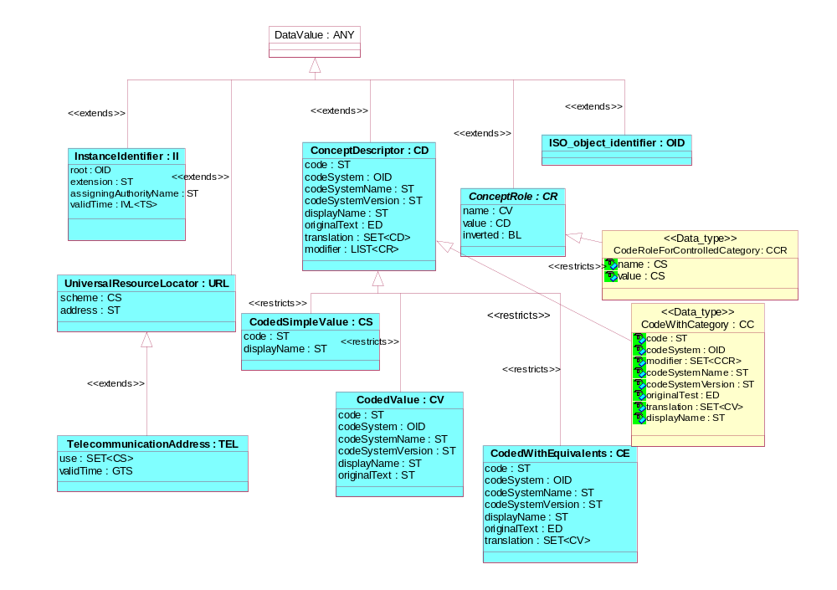
Thing Datatypes
March 2008
HL7 RIM-Based Database Design
<number> of 115

Slide 27
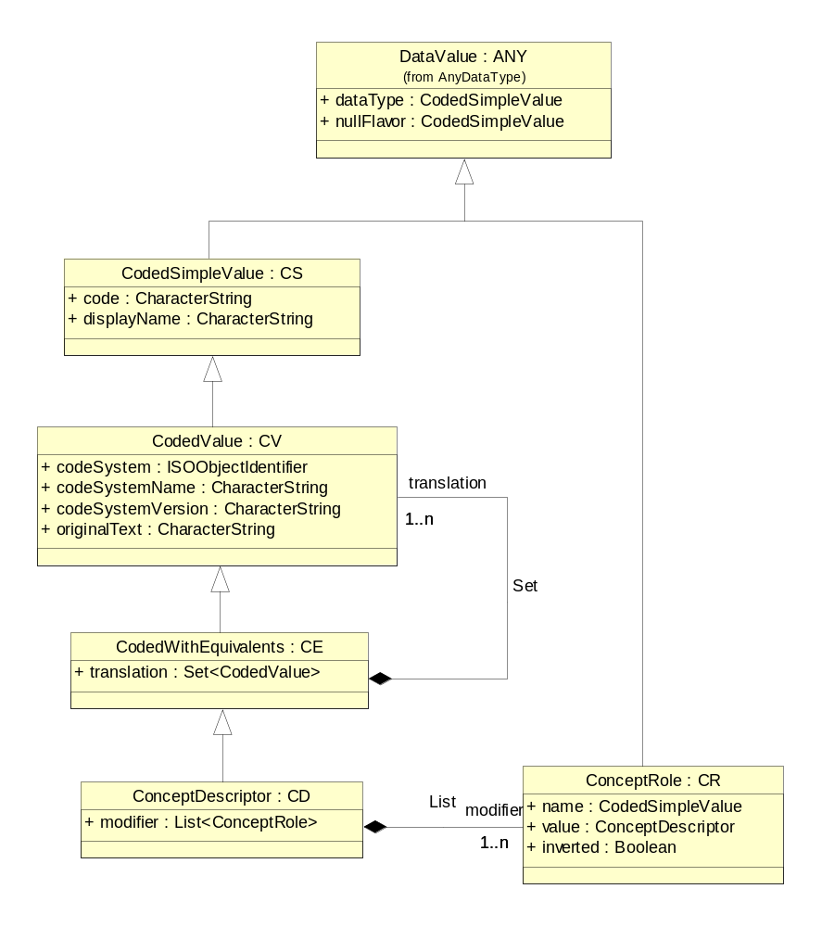
Concept Descriptor Data Types
March 2008
HL7 RIM-Based Database Design
<number> of 115

Slide 28

Reductionist View of Concept Descriptor
ConceptDescriptor : CD
-
dataType: CodedSimpleValue
CodedValue : CV
-
nullFlavor: CodedSimpleValue
-
dataType: CodedSimpleValue
-
code: CharacterString
+translation
-
nullFlavor: CodedSimpleValue
-
displayName: CharacterString
-
code: CharacterString
-
codeSystem: ISOObjectIdentifier
«SET»
0..*
-
displayName: CharacterString
-
codeSystemName: CharacterString
-
codeSystem: ISOObjectIdentifier
-
codeSystemVersion: CharacterString
-
codeSystemName: CharacterString
-
originalText: CharacterString
-
codeSystemVersion: CharacterString
-/
translation: CodedValue [0..*] (SET)
-
originalText: CharacterString
-/
modifier: ConceptRole [0..*] (LIST)
«LIST»
+modifier
0..*
ConceptRole : CR
-
dataType: CodedSimpleValue
-
nullFlavor: CodedSimpleValue
-
name: CodedSimpleValue
-
value: ConceptDescriptor
-
inverted: Boolean
March 2008
HL7 RIM-Based Database Design
<number> of 115

Slide 29
HL7 Version 3.0
Vocabulary Specification
The HL7 Vocabulary Specification defines the set of all concepts that can be taken as valid values in an instance of a coded attribute or message element.
March 2008
HL7 RIM-Based Database Design
<number> of 115

Slide 30
HL7 V3 Vocabulary Specification
The HL7 V3 Vocabulary Specification defines concept domains used in RIM coded Attributes and coded data type properties.
A concept domain is an abstract collection of interrelated concepts. It describes the purpose or intent of a coded attribute.
A value set is a collection of coded concepts drawn from one or more code systems. A concept domain may be associated with many value sets.
A context expression provides a means of designating which value set(s) within a given domain are applicable for a given usage context.
A coded concept has a concept code assigned by the coding system and a concept designation which names the referenced concept.
A coded concept may be a parent concept for a collection of additional concepts within the same code system.
March 2008
HL7 RIM-Based Database Design
<number> of 115

Slide 31
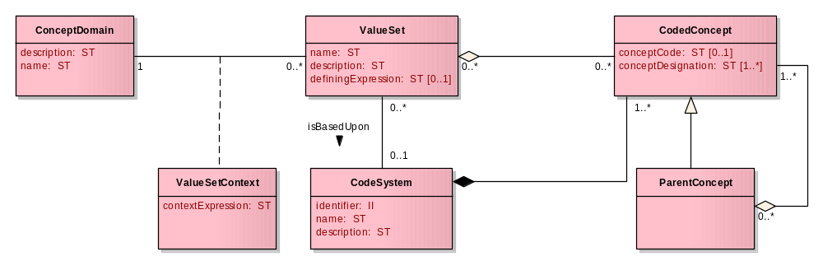
HL7 V3 Vocabulary Specification Metamodel
March 2008
HL7 RIM-Based Database Design
<number> of 115

Slide 32
Vocabulary Metamodel Description
A concept domain has a unique name and a description and is associated with zero, one, or more value set.
If a concept domain is associated with more than one value set, a value set context is used to specify the context under which each value set is relevant.
A value set is associated with one concept domain. It has a name and description. A value set is a collection of coded concepts from one or more code system.
The coded concepts included in a value set may be drawn from a single coding system according to a defining expression. A value set’s defining expression defines what subset, projection, or partition of the code system concepts are within the scope of the value set.
Context expression describes constraints, if any, governing the use of value sets. Constraints include restrictions on jurisdictions, medical specialties, time periods, and other factors that together describe the context for which the value set is relevant.
Coded concepts have a concept code as assigned by the coding system and a concept designation. The coded concept designation is the name of the coded concept.
Multiple designations are allowed for a coded concept, primarily to accommodate multiple languages.
A coded concept may be the parent concept of a collection of coded concepts. The parent concept is a generalization of the child concepts it collects. The parent concepts and its child concepts are part of the same value set.
March 2008
HL7 RIM-Based Database Design
<number> of 115

Slide 33
Normative RIM Structural Vocabulary
AcknowledgementCondition
AcknowledgementDetailCode
AcknowledgementDetailType
AcknowledgementMessageCode
AcknowledgementType
AcknowledgmentMessageType
ActClass
ActCode
ActInjuryCode
ActInvoiceElementModifier
ActMood
ActPatientTransportationModeCode
ActPaymentReason
ActPriority
ActProcedureCode
ActReason
ActRelationshipCheckpoint
ActRelationshipJoin
ActRelationshipRelatedOrder
ActRelationshipSplit
ActRelationshipSubset
ActRelationshipType
ActSite
ActStatus
ActTherapyDurationWorkingListCode
ActUncertainty
AddressPartType
AdministrativeGender
AmericanIndianAlaskaNativeLanguages
AttentionKeyword
BatchName
Calendar
CalendarCycle
CalendarType
CaseDetectionMethod
CaseDiseaseImported
CaseTransmissionMode
Charset
CodeSystem
CodeSystemType
CodingRationale
CommunicationFunctionType
CompressionAlgorithm
ConceptCodeRelationship
ConceptGenerality
ConceptPropertyId
ConceptStatus
Confidentiality
ContainerCap
ContainerSeparator
ContextControl
Country
CoverageEligibilityReason
Currency
DataType
DeviceAlertLevel
Diagnosis
DocumentCompletion
DocumentStorage
EditStatus
EducationLevel
ElementName
EmployeeJob
EmployeeJobClass
EmployeeSalaryType
EmploymentStatus
EncounterAccident
EncounterAcuity
EncounterAdmissionSource
EncounterDischargeDisposition
EncounterReferralSource
EncounterReferralSource
EncounterSpecialCourtesy
EntityClass
EntityCode
EntityDeterminer
EntityHandling
EntityNamePartQualifier
EntityNamePartType
EntityNameUse
EntityRisk
EntityStatus
EquipmentAlertLevel
Ethnicity
ExposureAgentEntityType
GTSAbbreviation
GenderStatus
HL7CommitteeIDInRIM
HL7ConformanceInclusion
HL7DefinedRoseProperty
HL7ITSVersionCode
HL7StandardVersionCode
HL7UpdateMode
HealthcareProviderTaxonomyHIPAA
HtmlLinkType
HumanActSite
HumanLanguage
ImagingSubjectOrientation
IndustryClassificationSystem
IntegrityCheckAlgorithm
InvoiceElementModifier
JobTitleName
LanguageAbilityMode
LanguageAbilityProficiency
ListOwnershipLevel
LivingArrangement
LocalMarkupIgnore
LocalRemoteControlState
MDFAttributeType
MDFSubjectAreaPrefix
ManagedParticipationStatus
ManufacturerModelName
MapRelationship
MaritalStatus
MaterialForm
MaterialType
MdfHmdMetSourceType
MdfHmdRowType
MdfRmimRowType
MediaType
MessageCondition
MessageWaitingPriority
ModifyIndicator
NullFlavor
ObservationInterpretation
ObservationMethod
ObservationValue
OrganizationIndustryClass
OrganizationNameType
OtherIndicationValue
ParameterizedDataType
ParticipationFunction
ParticipationMode
ParticipationSignature
ParticipationType
PatientImportance
PaymentTerms
PeriodicIntervalOfTimeAbbreviation
PersonDisabilityType
PostalAddressUse
PrescriptionDispenseFilterCode
ProbabilityDistributionType
ProcedureMethod
ProcessingID
ProcessingMode
ProviderCodes
QueryParameterValue
QueryPriority
QueryQuantityUnit
QueryRequestLimit
QueryResponse
QueryStatusCode
Race
Realm
RelationalName
RelationalOperator
RelationshipConjunction
ReligiousAffiliation
ResponseLevel
ResponseModality
ResponseMode
RoleClass
RoleCode
RoleLinkType
RoleStatus
RouteOfAdministration
SQLConjunction
Sequencing
SetOperator
SoftwareName
SpecialAccommodation
StyleType
SubstitutionCondition
TableCellHorizontalAlign
TableCellScope
TableCellVerticalAlign
TableFrame
TableRules
TargetAwareness
TelecommunicationAddressUse
TimingEvent
TribalEntityUS
URLScheme
UnitsOfMeasureCaseInsensitive
UnitsOfMeasureCaseSensitive
VaccineManufacturer
VaccineType
ValueSetOperator
ValueSetPropertyId
ValueSetStatus
VerificationMethod
VocabularyDomainQualifier
AcknowledgementCondition
AcknowledgementDetailCode
AcknowledgementDetailType
AcknowledgementMessageCode
AcknowledgementType
AcknowledgmentMessageType
ActClass
ActCode
ActInjuryCode
ActInvoiceElementModifier
ActMood
ActPatientTransportationModeCode
ActPaymentReason
ActPriority
ActProcedureCode
ActReason
ActRelationshipCheckpoint
ActRelationshipJoin
ActRelationshipRelatedOrder
ActRelationshipSplit
ActRelationshipSubset
ActRelationshipType
ActSite
ActStatus
ActTherapyDurationWorkingListCode
ActUncertainty
AddressPartType
AdministrativeGender
AmericanIndianAlaskaNativeLanguages
AttentionKeyword
BatchName
Calendar
CalendarCycle
CalendarType
CaseDetectionMethod
CaseDiseaseImported
CaseTransmissionMode
Charset
CodeSystem
CodeSystemType
CodingRationale
CommunicationFunctionType
CompressionAlgorithm
ConceptCodeRelationship
ConceptGenerality
ConceptPropertyId
ConceptStatus
Confidentiality
ContainerCap
ContainerSeparator
ContextControl
Country
CoverageEligibilityReason
Currency
DataType
DeviceAlertLevel
Diagnosis
DocumentCompletion
DocumentStorage
EditStatus
EducationLevel
ElementName
EmployeeJob
EmployeeJobClass
EmployeeSalaryType
EmploymentStatus
EncounterAccident
EncounterAcuity
EncounterAdmissionSource
EncounterDischargeDisposition
EncounterReferralSource
EncounterReferralSource
EncounterSpecialCourtesy
EntityClass
EntityCode
EntityDeterminer
EntityHandling
EntityNamePartQualifier
EntityNamePartType
EntityNameUse
EntityRisk
EntityStatus
EquipmentAlertLevel
Ethnicity
ExposureAgentEntityType
GTSAbbreviation
GenderStatus
HL7CommitteeIDInRIM
HL7ConformanceInclusion
HL7DefinedRoseProperty
HL7ITSVersionCode
HL7StandardVersionCode
HL7UpdateMode
HealthcareProviderTaxonomyHIPAA
HtmlLinkType
HumanActSite
HumanLanguage
ImagingSubjectOrientation
IndustryClassificationSystem
IntegrityCheckAlgorithm
InvoiceElementModifier
JobTitleName
LanguageAbilityMode
LanguageAbilityProficiency
ListOwnershipLevel
LivingArrangement
LocalMarkupIgnore
LocalRemoteControlState
MDFAttributeType
MDFSubjectAreaPrefix
ManagedParticipationStatus
ManufacturerModelName
MapRelationship
MaritalStatus
MaterialForm
MaterialType
MdfHmdMetSourceType
MdfHmdRowType
MdfRmimRowType
MediaType
MessageCondition
MessageWaitingPriority
ModifyIndicator
NullFlavor
ObservationInterpretation
ObservationMethod
ObservationValue
OrganizationIndustryClass
OrganizationNameType
OtherIndicationValue
ParameterizedDataType
ParticipationFunction
ParticipationMode
ParticipationSignature
ParticipationType
PatientImportance
PaymentTerms
PeriodicIntervalOfTimeAbbreviation
PersonDisabilityType
PostalAddressUse
PrescriptionDispenseFilterCode
ProbabilityDistributionType
ProcedureMethod
ProcessingID
ProcessingMode
ProviderCodes
QueryParameterValue
QueryPriority
QueryQuantityUnit
QueryRequestLimit
QueryResponse
QueryStatusCode
Race
Realm
RelationalName
RelationalOperator
RelationshipConjunction
ReligiousAffiliation
ResponseLevel
ResponseModality
ResponseMode
RoleClass
RoleCode
RoleLinkType
RoleStatus
RouteOfAdministration
SQLConjunction
Sequencing
SetOperator
SoftwareName
SpecialAccommodation
StyleType
SubstitutionCondition
TableCellHorizontalAlign
TableCellScope
TableCellVerticalAlign
TableFrame
TableRules
TargetAwareness
TelecommunicationAddressUse
TimingEvent
TribalEntityUS
URLScheme
UnitsOfMeasureCaseInsensitive
UnitsOfMeasureCaseSensitive
VaccineManufacturer
VaccineType
ValueSetOperator
ValueSetPropertyId
ValueSetStatus
VerificationMethod
VocabularyDomainQualifier
(Most vocabulary domains are published as informative references. Those domains that have a more formal ballot status are shown in bold in this table. See the domain for the exact status.)
(Most vocabulary domains are published as informative references. Those domains that have a more formal ballot status are shown in bold in this table. See the domain for the exact status.)
ActClass
ActStatus
ParticipationType
ActMood
ContextControl
RelationshipConjunction
ActRelationshipCheckpoint
EntityClass
RoleClass
ActRelationshipJoin
EntityDeterminer
RoleLinkType
ActRelationshipSplit
EntityStatus RoleStatus
ActRelationshipType
ManagedParticipationStatus
March 2008
HL7 RIM-Based Database Design
<number> of 115

Slide 34
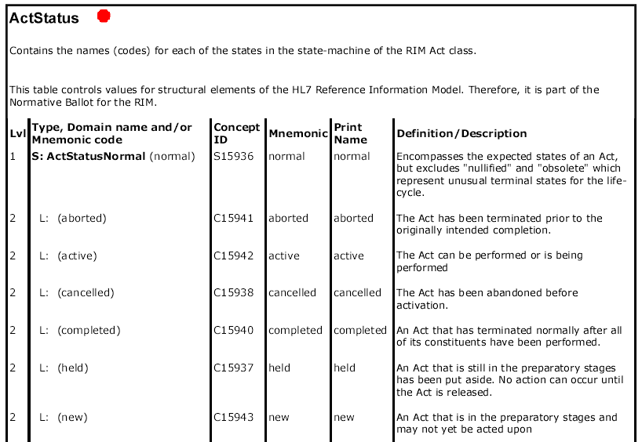
Vocabulary Specification Document
March 2008
HL7 RIM-Based Database Design
<number> of 115

Slide 35
Database Design Modeling Steps
Select a Subset of RIM Model Elements
Resolve Inheritance Anomalies
Specialize Attribute Datatypes
Resolve Collection Datatypes
Resolve Complex Datatypes
Transform Classes into Tables
Define Data Integrity Rules
Assign Primary, Foreign, and Alternate Keys
Optimize the Database Design Model
Generate Database Definition Language
Document Departures from the RIM
March 2008
HL7 RIM-Based Database Design
<number> of 115

Slide 36
Select a Subset of RIM Model Elements
Inputs:
  Project Scope
  Information Needs
  HL7 v3 RIM
Outputs:
  RIM Subset Model
Process:
  Select in-scope classes
  Select in-scope attributes
  Select in-scope relationships
This activity involves reviewing the project scope and information needs to identify the RIM model elements of interest.
Select the relevant classes, attributes, and relationships for the project.
This subset becomes the starting point for the design.
The subset definition rationale should also be documented.
March 2008
HL7 RIM-Based Database Design
<number> of 115

Slide 37
Example Project
Project Scope
  Construct a RIM-based relational database structure to persist the data content of immunization related messages used in the California Statewide Immunization Information System (SIIS) System Integration Project (SIP)
Information Needs
  The information needs of the SIIS SIP immunization database are documented in the SIIS SIP Message Profile and SIIS SIP Logical Data Model
March 2008
HL7 RIM-Based Database Design
<number> of 115

Slide 38
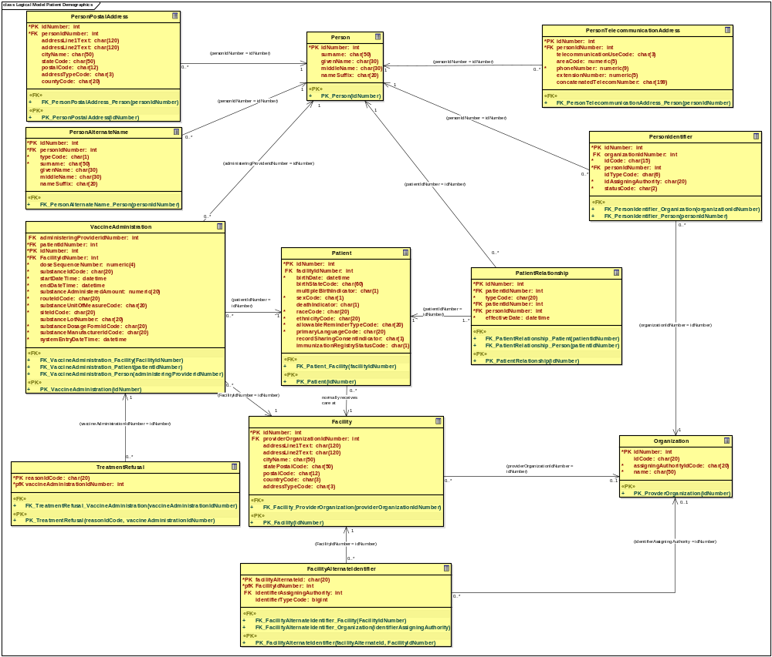
SIIS SIP Logical Data Model
March 2008
HL7 RIM-Based Database Design
<number> of 115

Slide 39
SIIS SIP Logical Data Model Classes
Facility
Facility Alternate Identifier
Organization
Patient
Patient Relationship
Person
PersonAlternateName
PersonIdentifier
PersonPostalAddress
PersonTelecommunicationAddress
Treatment Refusal
Vaccine Administration
March 2008
HL7 RIM-Based Database Design
<number> of 115

Slide 40
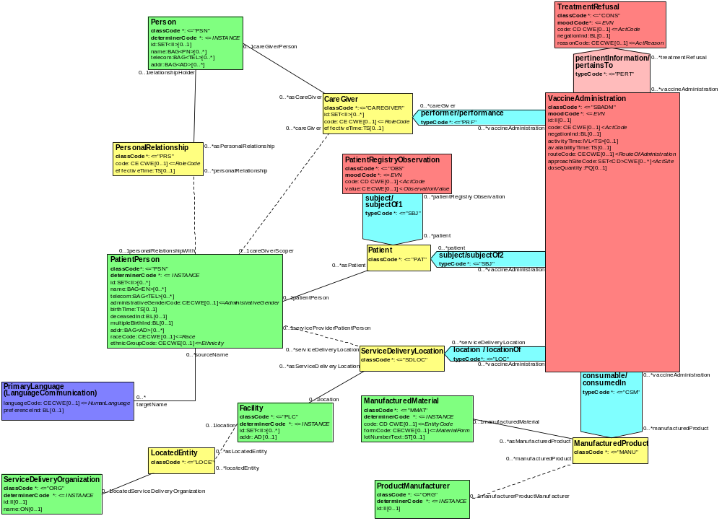
SIIS SIP Information Needs RMIM
March 2008
HL7 RIM-Based Database Design
<number> of 115

Slide 41
SIIS SIP Project Related RIM Classes
Entity (Person, Organization, Place, Material)
Living Subject (Person)
Person (Patient Person, Associated Person)
Language Communication (Primary Language)
Organization (Service Delivery Organization, Manufacturer)
Place (Facility)
Material (Manufactured Material)
Manufactured Material (Vaccine)
Role (Personal Relationship, CareGiver, Patient, Service Delivery Location, Located Entity, Manufactured Product)
Participation (Performer, Subject, Location, Consumable)
Act (Substance Administration, Observation, Consent)
Act Relationship (Pertains)
Consent (Treatment Refusal)
Observation (Patient Registry Observation)
Substance Administration (Vaccine Administration)
March 2008
HL7 RIM-Based Database Design
<number> of 115

Slide 42
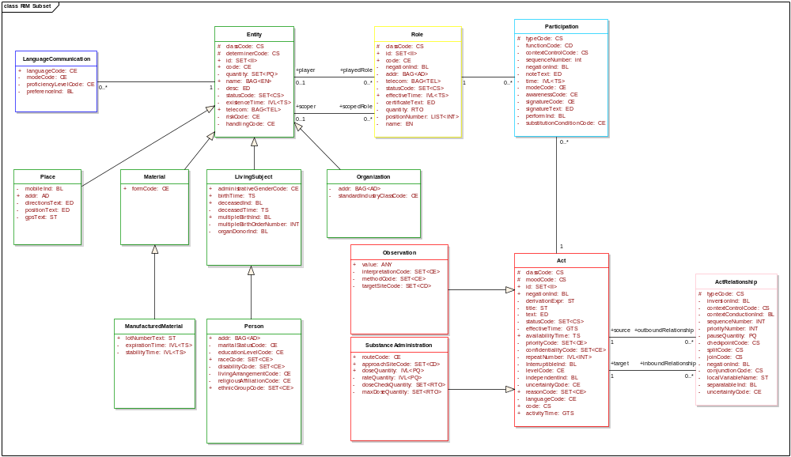
SIIS SIP RIM Class Subset Model (Level 0)
March 2008
HL7 RIM-Based Database Design
<number> of 115

Slide 43
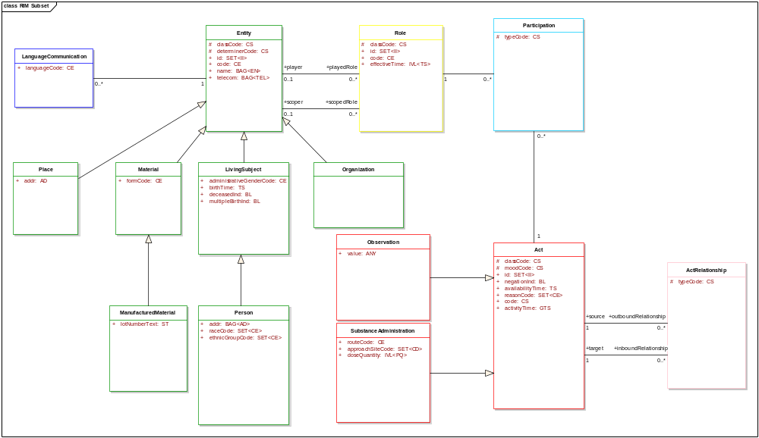
SIIS SIP RIM Attribute Subset Model (Level 1)
March 2008
HL7 RIM-Based Database Design
<number> of 115

Slide 44
Database Design Modeling Steps
Select a Subset of RIM Model Elements
Resolve Inheritance Anomalies
Specialize Attribute Datatypes
Resolve Collection Datatypes
Resolve Complex Datatypes
Transform Classes into Tables
Define Data Integrity Rules
Assign Primary, Foreign, and Alternate Keys
Optimize the Database Design Model
Generate Database Definition Language
Document Departures from the RIM
March 2008
HL7 RIM-Based Database Design
<number> of 115

Slide 45
Resolve Inheritance Anomalies
Inputs:
  RIM Subset Model (Level 1)
  Information Needs
Outputs:
  RIM Subset Model (Level 2)
Process:
  Propagate and promote attributes and associations as needed.
  Eliminate unnecessary classes and inherited attributes
  Replace generalization relationships with optional one-to-one associations.
This activity involves streamlining the RIM subset model to eliminated unnecessary inheritance structures.
Specialization classes inherit attributes and associations from parent generalization classes.
Three basic approaches are used to eliminate inheritance:
  Association Method
  Propagation Method
  Promotion Method
Generalization relationships are replaced by optional one-to-one association relationships.
Consideration must be given to resolving inherited association relationships.
Not all inherited attributes and associations are relevant for the design project scope and information needs.
March 2008
HL7 RIM-Based Database Design
<number> of 115

Slide 46
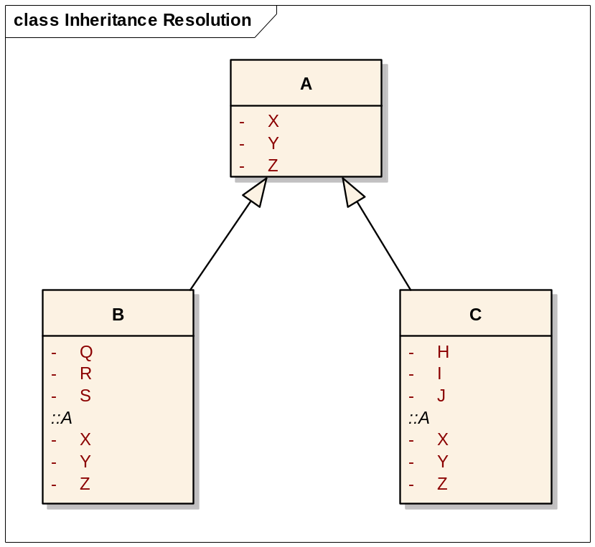
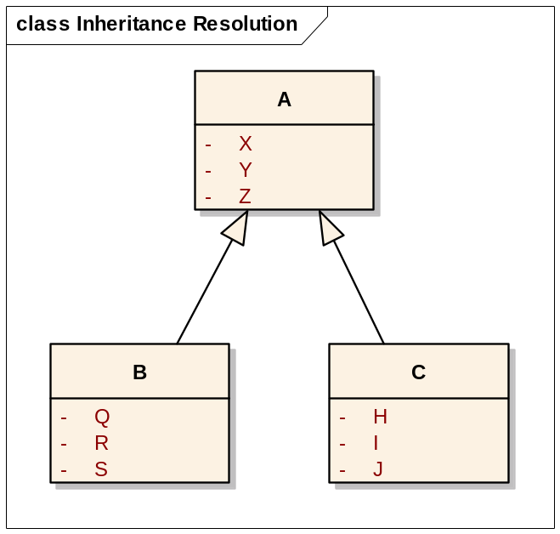
Generalization Relationships Indicate Inheritance
=
March 2008
HL7 RIM-Based Database Design
<number> of 115

Slide 47
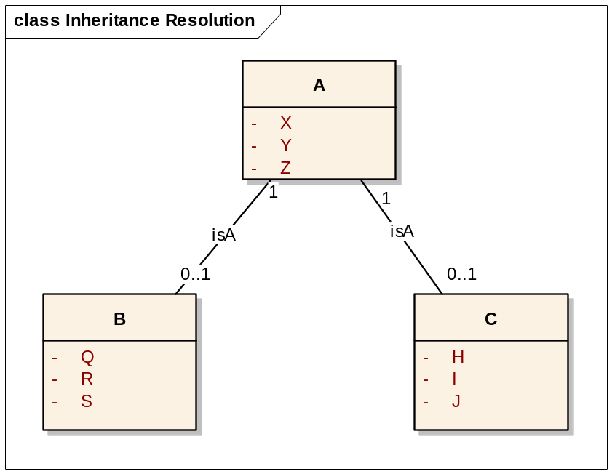
Association Method
=
Replace the generalization relationships with optional one-to-one association relationships
March 2008
HL7 RIM-Based Database Design
<number> of 115

Slide 48
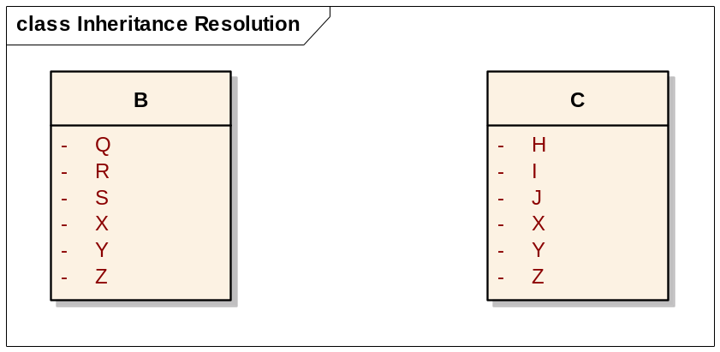
Propagation Method
=
Propagate attributes and associations from the parent generalization class into child specialization classes
March 2008
HL7 RIM-Based Database Design
<number> of 115

Slide 49
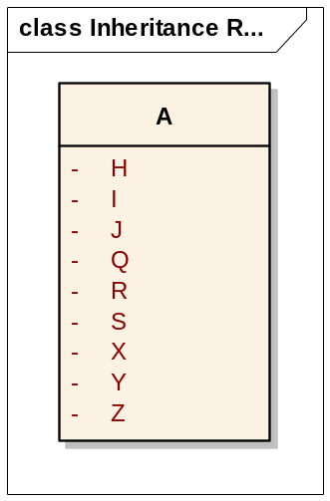
Promotion Method
=
Promote attributes and associations from child specialization classes into their parent generalization class
March 2008
HL7 RIM-Based Database Design
<number> of 115

Slide 50
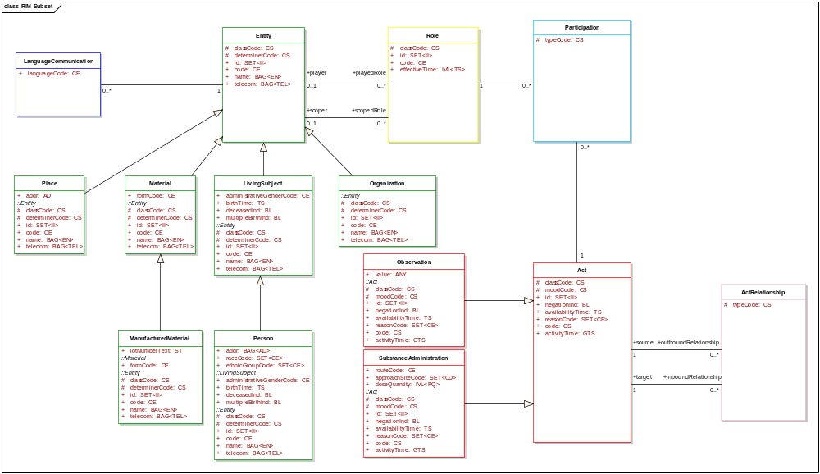
RIM Subset Model (Inheritance Exposed)
March 2008
HL7 RIM-Based Database Design
<number> of 115

Slide 51
RIM Subset Model (Inheritance Anomalies)
Unnecessarily inherited structural attributes with immutable values (classCode, determinerCode, moodCode).
Place name and telcom attributes are out of scope.
Person id and code attributes are out of scope
Material id, name and telcom attributes are out of scope.
Organization telcom attribute is out of scope.
Observation negation indicator, availability time, reason code, and activity time are out of scope.
Substance administration reason code is out of scope.
The association to language communication class is out of scope for place, manufactured material, and organization.
Material and living subject classes are superfluous.
March 2008
HL7 RIM-Based Database Design
<number> of 115

Slide 52
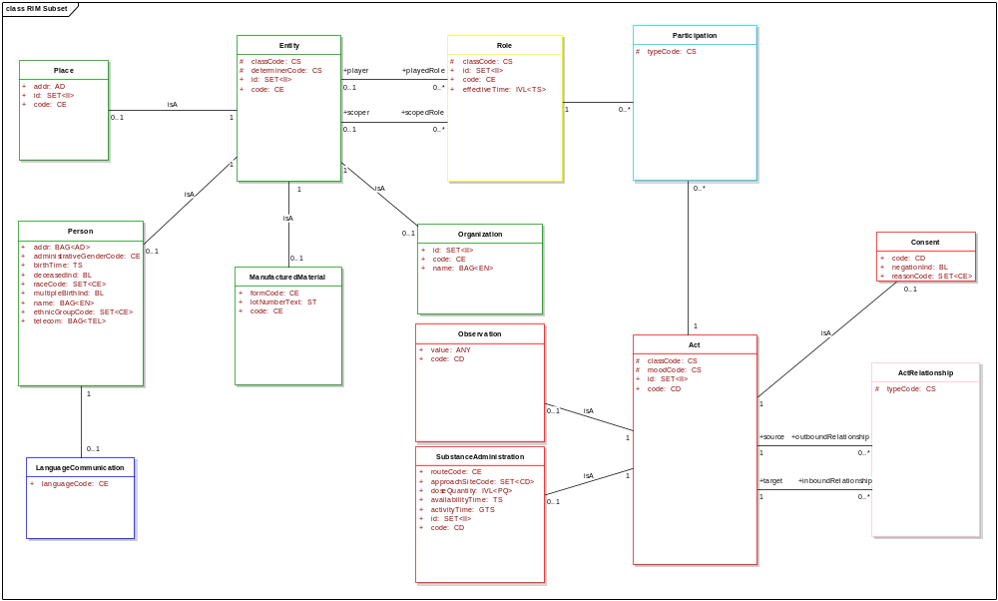
RIM Subset Model (Inheritance Anomalies Resolved)
March 2008
HL7 RIM-Based Database Design
<number> of 115

Slide 53
Database Design Modeling Steps
Select a Subset of RIM Model Elements
Resolve Inheritance Anomalies
Specialize Attribute Datatypes
Resolve Collection Datatypes
Resolve Complex Datatypes
Transform Classes into Tables
Define Data Integrity Rules
Assign Primary, Foreign, and Alternate Keys
Optimize the Database Design Model
Generate Database Definition Language
Document Departures from the RIM
March 2008
HL7 RIM-Based Database Design
<number> of 115

Slide 54
Specialize Attribute Datatypes
Inputs:
  RIM Subset Model (Level 2)
  Information Needs
Outputs:
  RIM Subset Model (Level 3)
Process:
  Replace collection datatypes with non-collection datatypes.
  Replace generic datatypes with dependent child datatypes
  Replace all concept descriptor datatypes with the CD datatype
This activity involves replacing the RIM abstract datatypes with project domain specific datatypes.
RIM collections datatypes (LIST, SET, and BAG) are used for repeating attributes.
Eliminate collection datatypes where attribute repetition is inconsistent with information needs.
RIM generic datatypes (EN, QTY, GTS, and ED) are intentionally abstract.
Replace generic datatypes with more domain suitable datatypes.
RIM concept descriptor datatypes (CS, CV, CE, and CE) provide a diverse approach to handling vocabulary needs.
Replace all concept descriptor datatypes with CD to provide a uniform approach to handling vocabulary needs.
March 2008
HL7 RIM-Based Database Design
<number> of 115

Slide 55
RIM Subset Model (Level 2)
March 2008
HL7 RIM-Based Database Design
<number> of 115

Slide 56
Attributes with Collection Datatypes
Entity.id : SET<II>
Place.id : SET<II>
Person.addr : BAG<AD>
Person.raceCode : SET<CE>
Person.name : BAG<EN>
Person.ethnicGroupCode : SET<CE>
Person.telcom : BAG<TEL>
Organization.id : SET<II>
Organization.name : BAG<EN>
Role.id : SET<II>
Act.id : SET<II>
SubstanceAdministration.approachSiteCode : SET<CD>
SubstanceAdminstration.id : SET<II>
Consent.reasonCode : SET<CE>
March 2008
HL7 RIM-Based Database Design
<number> of 115

Slide 57
Assessed Attributes with Collection Datatypes
Entity.id : SET<II>
Place.id : SET<II>
Person.addr : BAG<AD>
Person.raceCode : SET<CE>
Person.name : BAG<EN>
Person.ethnicGroupCode : SET<CE>
Person.telcom : BAG<TEL>
Organization.id : SET<II>
Organization.name : BAG<EN>
Role.id : SET<II>
Act.id : SET<II>
SubstanceAdministration.approachSiteCode : SET<CD>
SubstanceAdminstration.id : SET<II>
Consent.reasonCode : SET<CE>
March 2008
HL7 RIM-Based Database Design
<number> of 115

Slide 58
Assessed Attributes with Collection Datatypes
Entity.id : SET<II>
Place.id : SET<II>
Person.addr : BAG<AD>
Person.raceCode : CE
Person.name : BAG<EN>
Person.ethnicGroupCode : CE
Person.telcom : BAG<TEL>
Organization.id : II
Organization.name : EN
Role.id : SET<II>
Act.id : II
SubstanceAdministration.approachSiteCode : CD
SubstanceAdminstration.id : II
Consent.reasonCode : CE
March 2008
HL7 RIM-Based Database Design
<number> of 115

Slide 59

RIM Subset Model (Level 2.1)
March 2008
HL7 RIM-Based Database Design
<number> of 115

Slide 60
Attributes with Generic Datatypes
Person.name : BAG<EN> replace with BAG<PN>
Organization.name : EN replace with ON
SubtanceAdministration.activityTime : GTS replace with IVL<TS>
March 2008
HL7 RIM-Based Database Design
<number> of 115

Slide 61
RIM Subset Model (Level 2.2)
class RIM Subset
Entity
Role
Participation
#
classCode: CS
#
classCode: CS
#
typeCode: CS
Place
#
determinerCode: CS
+player
+playedRole
+
id: SET<II>
+
addr: AD
+
id: SET<II>
0..1
0..*
+
code: CE
+
id: SET<II>
+
code: CE
+
effectiveTime: IVL<TS>
+
code: CE
0..1
isA
1
+scoper
+scopedRole
1
0..*
0..1
0..*
1
1
isA
1
isA
0..*
Person
isA
+
addr: BAG<AD>
0..1
Organization
Consent
+
administrativeGenderCode: CE
0..1
0..1
+
id: II
+
code: CD
+
birthTime: TS
+
code: CE
+
negationInd: BL
+
deceasedInd: BL
ManufacturedMaterial
+
name: ON
+
reasonCode: CE
+
raceCode: CE
+
formCode: CE
0..1
+
multipleBirthInd: BL
+
lotNumberText: ST
+
name: BAG<PN>
+
code: CE
+
ethnicGroupCode: CE
+
telecom: BAG<TEL>
Observation
1
isA
+
value: ANY
Act
+
code: CD
#
classCode: CS
#
moodCode: CS
ActRelationship
+
id: II
1
+
code: CD
#
typeCode: CS
0..1
isA
1
0..1
1
+source
+outboundRelationship
SubstanceAdministration
1
0..*
LanguageCommunication
+
routeCode: CE
isA
1
+target
+inboundRelationship
+
languageCode: CE
+
approachSiteCode: CD
+
doseQuantity: IVL<PQ>
1
0..*
+
availabilityTime: TS
0..1
+
activityTime: IVL<TS>
+
id: II
+
code: CD
March 2008
HL7 RIM-Based Database Design
<number> of 115

Slide 62
Attributes with Concept Descriptor Datatypes
Entity.classCode : CS
Entity.determinerCode : CS
Entity.code : CE
Place.code : CE
Person.administrativeGenderCode : CE
Person.raceCode : CE
Person.ethnicGroupCode : CE
LanguageCommuniction.languageCode : CE
ManufacturedMaterial.formCode : CE
ManufacturedMaterial.code : CE
Role.ClassCode : CS
Role.code : CE
Organization.code : CE
Observation.value : CD
Observation.code : CD
SubstanceAdministration.routeCode : CE
SubstanceAdminstration.approachSiteCode : CD
SubstanceAdministration.code : CD
Participation.typeCode : CS
Act.classCode : CS
Act.moodCode : CS
Act.code : CD
Consent.code :CD
Consent.reasonCode : CE
ActRelationship.typeCode : CS
March 2008
HL7 RIM-Based Database Design
<number> of 115

Slide 63

RIM Subset Model (Level 3)
March 2008
HL7 RIM-Based Database Design
<number> of 115

Slide 64
Database Design Modeling Steps
Select a Subset of RIM Model Elements
Resolve Inheritance Anomalies
Specialize Attribute Datatypes
Resolve Collection Datatypes
Resolve Complex Datatypes
Transform Classes into Tables
Define Data Integrity Rules
Assign Primary, Foreign, and Alternate Keys
Optimize the Database Design Model
Generate Database Definition Language
Document Departures from the RIM
March 2008
HL7 RIM-Based Database Design
<number> of 115

Slide 65
Resolve Collection Datatypes
Inputs:
  RIM Subset Model (Level 3)
  Information Needs
Outputs:
  RIM Subset Model (Level 4)
Process:
  Promote SET, LIST, and BAG attributes to dependent classes
  Replace IVL attributes with a pair of from/thru attributes where appropriate.
  Replace IVL attributes with a single low, center, width, or high value where appropriate.
This step involves revising the RIM subset model to have only single value attributes.
The SET, LIST, and BAG datatypes indicate that the attribute may assume multiple values.
  SET indicates the attribute values are unique.
  LIST indicates the attribute values are ordered.
  BAG indicates the attribute values are non-unique and unordered.
The Interval (IVL) datatype indicates that the attribute is a an interval of values including:
  Low value
  Center value
  Width value
  High value
March 2008
HL7 RIM-Based Database Design
<number> of 115

Slide 66
RIM Subset Model (Level 3)
March 2008
HL7 RIM-Based Database Design
<number> of 115

Slide 67
Attributes with Collection Datatypes
Entity.id : SET<II>
Place.id : SET<II>
Person.addr : BAG<AD>
Person.name : BAG<PN>
Person.telcom : BAG<TEL>
Role.id : SET<II>
Role.effectiveTime : IVL<TS>
SubstanceAdministration.doseQuantity : IVL<PQ>
SubstanceAdministration.activityTime : IVL<TS>
March 2008
HL7 RIM-Based Database Design
<number> of 115

Slide 68
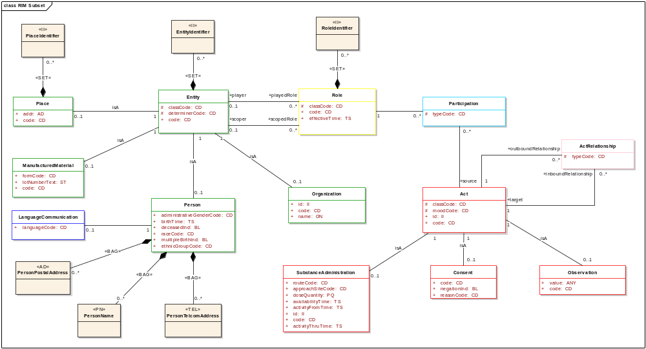
RIM Subset Model (Level 4)
March 2008
HL7 RIM-Based Database Design
<number> of 115

Slide 69
Database Design Modeling Steps
Select a Subset of RIM Model Elements
Resolve Inheritance Anomalies
Specialize Attribute Datatypes
Resolve Collection Datatypes
Resolve Complex Datatypes
Transform Classes into Tables
Define Data Integrity Rules
Assign Primary, Foreign, and Alternate Keys
Optimize the Database Design Model
Generate Database Definition Language
Document Departures from the RIM
March 2008
HL7 RIM-Based Database Design
<number> of 115

Slide 70
Resolve Complex Datatypes
Inputs:
  RIM Subset Model (Level 4)
  Information Needs
Outputs:
  RIM Subset Model (Level 5)
Process:
  Replace attributes with complex datatypes with attributes representing the structural features of their underlying datatypes.
  Prepare a structure for common handling of attributes with concept descriptor datatypes.
  Prepare a structure for handling attributes with the ANY datatype.
This step involves revising the RIM subset model to have only primitive attributes.
Prepare a data model of the complex datatypes used within the RIM subset model.
Remove optional datatype features where possible.
Simplify the datatype model structure by consolidating classes where possible
Use the datatype data model to guide replacement of complex attributes in the RIM subset model.
Prepare a structure to manage coded concepts.
Prepare a data structure with the flexibility to handle the ANY datatype.
March 2008
HL7 RIM-Based Database Design
<number> of 115

Slide 71
RIM Subset Model (Level 4)
March 2008
HL7 RIM-Based Database Design
<number> of 115

Slide 72
Complex Datatypes Use in the RIM Subset Model
II : Instance Identifier
AD : Postal Address
PN : Person Name
ON : Organization Name
TEL : Telecommunication Address
PQ : Physical Quantity
CD : Concept Descriptor
ANY : Data Value
March 2008
HL7 RIM-Based Database Design
<number> of 115

Slide 73
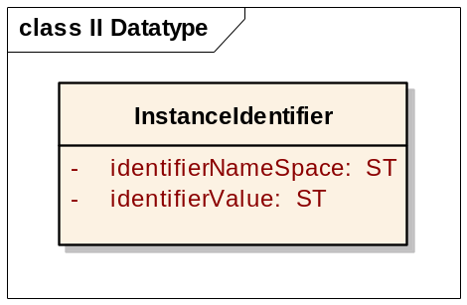
Instance Identifier
March 2008
HL7 RIM-Based Database Design
<number> of 115

Slide 74
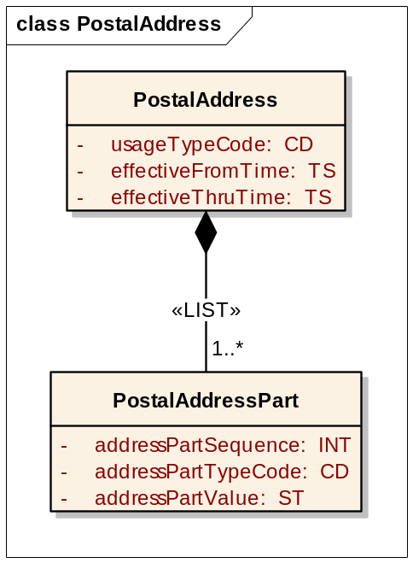
Postal Address
March 2008
HL7 RIM-Based Database Design
<number> of 115

Slide 75
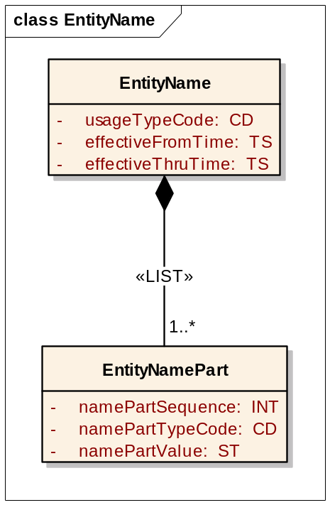
Entity Name
March 2008
HL7 RIM-Based Database Design
<number> of 115

Slide 76
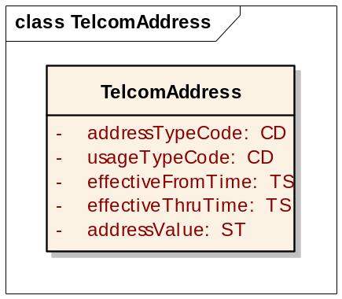
Telecommunication Address
March 2008
HL7 RIM-Based Database Design
<number> of 115

Slide 77
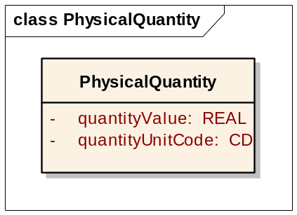
Physical Quantity
March 2008
HL7 RIM-Based Database Design
<number> of 115

Slide 78
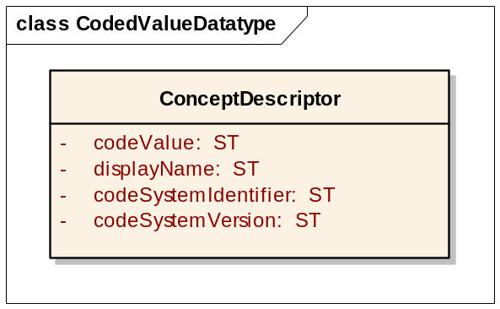
Property Summary of Concept Descriptor
March 2008
HL7 RIM-Based Database Design
<number> of 115

Slide 79
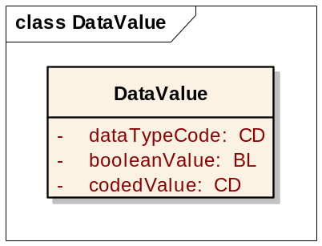
Data Value
March 2008
HL7 RIM-Based Database Design
<number> of 115

Slide 80
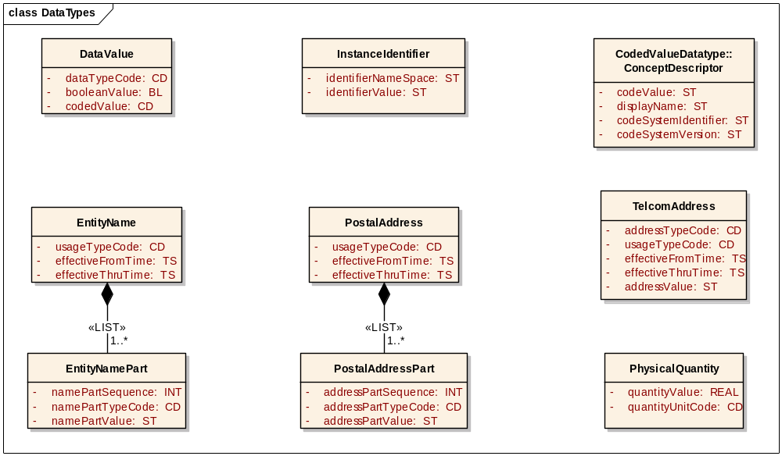
Complex Datatypes
March 2008
HL7 RIM-Based Database Design
<number> of 115

Slide 81
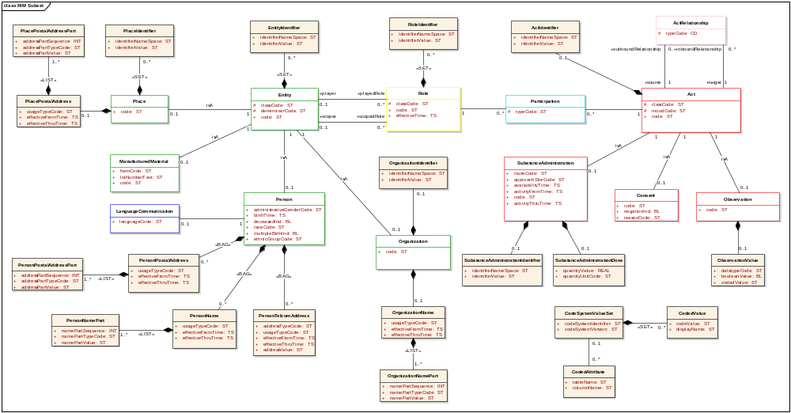
RIM Subset Model (Level 5)
March 2008
HL7 RIM-Based Database Design
<number> of 115

Slide 82
Database Design Modeling Steps
Select a Subset of RIM Model Elements
Resolve Inheritance Anomalies
Specialize Attribute Datatypes
Resolve Collection Datatypes
Resolve Complex Datatypes
Transform Classes into Tables
Define Data Integrity Rules
Assign Primary, Foreign, and Alternate Keys
Optimize the Database Design Model
Generate Database Definition Language
Document Departures from the RIM
March 2008
HL7 RIM-Based Database Design
<number> of 115

Slide 83
Transform Classes into Tables
Inputs:
  RIM Subset Model (Level 5)
  Information Needs
Outputs:
  Logical Data Model (Level 1)
Process:
  Select a database management system.
  Add a table to the Logical Data Model for each class in the RIM Subset Model (Level 5).
  Add a column to each Logical Data Model table for each attribute in the RIM Subset Model (Level 5).
This step involves creation of a level one Logical Data Model.
Select a database management system for the LDM.
Add tables to the LDM. Adopt a naming convention that obeys table naming constraints of the DBMS.
Add columns to the LDM. Adopt a naming convention that obeys column naming constraints of the DBMS.
Assign datatypes to columns in the LDM. Adopt a pattern for assigning datatypes in the LDM based upon datatypes and other factors in the RIM Subset Model.
Add relationships between tables. Use navigation to depict foreign key reference direction.
March 2008
HL7 RIM-Based Database Design
<number> of 115

Slide 84
Develop Modeling Conventions for the LDM
Keep table and column names to less than 30 characters.
Use a consistent set of abbreviations in table and column names.
Prefix table names with E, R, P, or A to correspond to classes based upon Entity, Role, Participation, and Act.
Establish additional table name prefixes conventions for classes not based upon Entity, Role, Participation, and Act.
Assign column datatypes based upon a consistent mapping of V3 primitive datatypes to DBMS datatypes.
Use a consistent length for columns based upon the attribute type in the RIM subset model.
March 2008
HL7 RIM-Based Database Design
<number> of 115

Slide 85
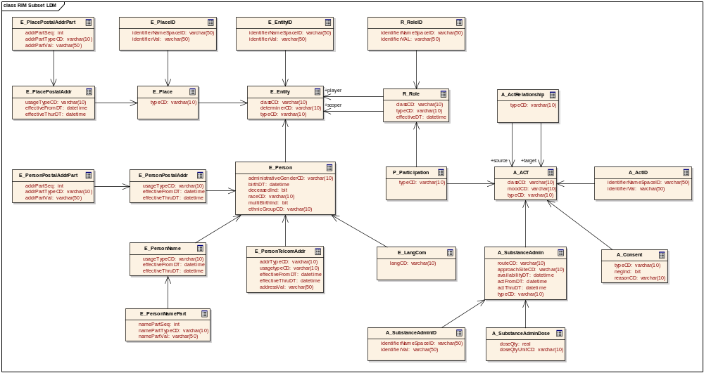
RIM Logical Data Model (Level 1)
March 2008
HL7 RIM-Based Database Design
<number> of 115

Slide 86
Database Design Modeling Steps
Select a Subset of RIM Model Elements
Resolve Inheritance Anomalies
Specialize Attribute Datatypes
Resolve Collection Datatypes
Resolve Complex Datatypes
Transform Classes into Tables
Define Data Integrity Rules
Assign Primary, Foreign, and Alternate Keys
Optimize the Database Design Model
Generate Database Definition Language
Document Departures from the RIM
March 2008
HL7 RIM-Based Database Design
<number> of 115

Slide 87
Define Data Integrity Rules
Inputs:
  Logical Data Model (Level 1)
  Information Needs
Outputs:
  Data Integrity Rules
  Logical Data Model (Level 2)
Process:
  Define column integrity rules
  Define referential integrity rules
  Update the LDM
  Document data integrity rules
This step involves specification of data integrity rules and the creation of a level two Logical Data Model.
Define column integrity rules which specify:
  Optionality
  Uniqueness
  Update
  Derivation
  Value constraint
Define table relationship rule which specify:
  Insert / Update rules
  Delete rules
  Cardinality rules
Update the LDM and document the data integrity rules.
March 2008
HL7 RIM-Based Database Design
<number> of 115

Slide 88
Column Integrity Rules
All columns should have integrity rules specified.
Three important integrity rules to include are optionality, uniqueness, and update.
  Optionality indicates if the column is required (must always have value), optional (may be unvalued), conditional (must be valued under certain conditions)
  Uniqueness specifies whether multiple instances of the table are allowed to have the same value for this column. The uniqueness specification may reference other columns in the same table that in combination with this column must be unique. Specify as unique, not-unique, or unique in combination
  Update specifies if the value of the column is allowed to be modified once the instance of the table has been created.
Integrity rules should be used to specify derivation algorithms for derived columns. A derived column is an column whose value can be determined algorithmically from other columns also in the model.
Any constraints on the allowable values of an column that is conditioned by the value of other columns should be documented as an integrity rule.
March 2008
HL7 RIM-Based Database Design
<number> of 115

Slide 89
Determine Table Relationship Rules
Table relationship rules are data integrity rules specified on relationships. The table relationship rules govern the effects of insert, delete, and update operations on relationships.
Table relationship rules are sometimes referred to as “referential integrity rules” because they govern the integrity of the references from one table to another (i.e., primary and foreign keys).
Insert and Update rules apply to child tables (tables on the “many” side of a one-to-many relationship). They specify what restrictions associated parent tables (tables on the “one” side of the one-to-many relationship) impose upon the insert of a row in child table or the update of foreign key columns.
Possible insert/update rules are: Dependent, Automatic, Nullify, Default, Customize, and None.
Delete rules apply to the parent table. They specify what restrictions the associated child tables impose upon the deletion of a row in the parent table or an update to its primary key.
Possible delete rules are: Restrict, Cascade, Nullify, Default, Customize, and None.
March 2008
HL7 RIM-Based Database Design
<number> of 115

Slide 90
Referential Integrity Rules
Insert/Update Rules
Dependent: Permit insertion of child table instance only when matching parent table instance already exist.
Automatic: Always permit insertion of child table instance. If matching parent table instance does not already exist, create it.
Nullify: Always permit insertion of child table instance. If matching parent table instances does not already exist, set foreign key in child to null.
Default: Always permit insertion of child table instance. If matching parent table instance does not exist, set foreign key in child to a previously defined default value.
Customize: Permit insertion of child table instance only if certain customize validity constraints are met.
None: Always permit insertion of child table instance. No matching parent table instance need exist, and thus no validity checking need be done.
Delete Rules
Restrict: Permit deletion of parent table instance only when there are no matching child table instances.
Cascade: Always permit deletion of parent table instance and cascade the deletion to any matching child table instances.
Nullify: Always permit deletion of parent table instance. If any matching child table instances exist, set their foreign keys to null.
Default: Always permit deletion of parent table instance. If any matching child table instances exist, set their foreign keys to a previously defined default.
Customized: Permit deletion of parent table instance only if certain customized validity constraints are met.
None: Always permit deletion of parent table instance. Matching child table instances may or may not exist, and thus no validity checking need be done.
March 2008
HL7 RIM-Based Database Design
<number> of 115

Slide 91

Sample referential integrity rules
Each E_Entity sometimes is a E_Place; on delete restrict.
Each E_Place always is a E_Entity; insert/update dependent.
Each E_Place sometime has one E_PlacePostalAddr; on delete cascade.
Each E_PlacePostalAddr always pertains to one E_Place; insert/update dependent.
Each E_PlacePostalAddr always has one or more E_PlacePostalAddrPart; on delete cascade.
Each E_PlacePostalAddrPart always pertains to one E_PlacePostalAddr; insert/update dependent.
Each E_Entity sometimes is a E_Person; on delete restrict.
Each E_Person always is a E_Entity; insert/update dependent.
Each E_Person sometime has one or more E_PersonPostalAddr; on delete cascade.
Each E_PersonPostalAddr always pertains to one E_Person; insert/update dependent.
Each E_PersonPostalAddr always has one or more E_PersonPostalAddrPart; on delete cascade.
Each E_PersonPostalAddrPart always pertains to one E_PersonPostalAddr; insert/update dependent.
March 2008
HL7 RIM-Based Database Design
<number> of 115

Slide 92
Sample column integrity rules
E_Entity.classCD
  Required, Not Unique, Immutable
  Must have matching CodedValue.codeValue
E_Entity.typeCD
  Conditional, Not Unique, Updateable
  Must have matching CodedValue.codeValue
  Required if classCD is PLC, ORG, or MAT
E_Person.administrativeGenderCD
  Optional, Not Unique, Updateable
  Must have matching CodedValue.codeValue
E_Person.birthDT
  Optional, Not Unique, Updateable
  Must be less than or equal to current date
E_Person.deceasedInd
  Optional, Not Unique, Updateable
E_PersonTelcomAddr.addrTypeCD
  Required, Not Unique, Updateable
  Must have matching CodedValue.codeValue
E_PersonTelcomAddr.effectiveFromDT
  Optional, Not Unique, Updateable
  Must be less than or equal to effectiveThruDT
March 2008
HL7 RIM-Based Database Design
<number> of 115

Slide 93

RIM Logical Data Model (Level 2)
March 2008
HL7 RIM-Based Database Design
<number> of 115

Slide 94
Database Design Modeling Steps
Select a Subset of RIM Model Elements
Resolve Inheritance Anomalies
Specialize Attribute Datatypes
Resolve Collection Datatypes
Resolve Complex Datatypes
Transform Classes into Tables
Define Data Integrity Rules
Assign Primary, Foreign, and Alternate Keys
Optimize the Database Design Model
Generate Database Definition Language
Document Departures from the RIM
March 2008
HL7 RIM-Based Database Design
<number> of 115

Slide 95
Assign Primary, Foreign, and Alternate Keys
Inputs:
  Logical Data Model (Level 2)
  Data Integrity Rules
Outputs:
  Logical Data Model (Level 3)
Process:
  Identify candidate keys
  Assign primary keys
  Propagate foreign keys
This step involves creation of a level two Logical Data Model.
Assess the data integrity rules for table columns to determine a list of candidate keys.
Choose a primary key from among the list of candidates or assign a surrogate key.
Propagate primary keys to dependent tables as foreign keys.
March 2008
HL7 RIM-Based Database Design
<number> of 115

Slide 96

Specify Table Keys
A key is an attribute or minimal set of attributes that uniquely identifies a specific occurrence of a table.
Many different types of keys may be specified for a table.
  Candidate Keys
  Primary Keys
  Alternate Keys
  Foreign Keys
  Composite Keys
  Surrogate Keys
All tables must have a primary key specified.
In addition to keys, some tables may have an inversion entry specified.
March 2008
HL7 RIM-Based Database Design
<number> of 115

Slide 97
Types of Keys
Candidate Key: an attribute or group of attributes that might be chosen as a primary key
Primary Key: an attribute or group of attributes that have been chosen as the unique identifier of a table
Alternate Key: a candidate key that has not been chosen as the primary key
Foreign Key: an attribute or group of attributes in a table that is the primary key of a parent table
Composite Key: a primary key that contains two or more attributes, possibly foreign keys
Surrogate Key: a single meaningless attribute assigned as the primary key of a table
Inversion Entry: an attribute of group of attributes that will frequently be used to access a table but may not result in finding exactly one instance.
March 2008
HL7 RIM-Based Database Design
<number> of 115

Slide 98
Assigning Keys
Start with the tables that are only on the “one” side of one-to-many relationships (root tables).
Make a list of candidate keys
  Review the integrity rules for each attribute in the table
  List those attributes that are required and are unique either by themselves or in combination
Select a primary key
  Eliminate from the list of candidate keys those attributes that are updateable, derived, or have their allowable values constrained by other attributes.
  If no candidate keys remain, assign a surrogate key.
  If multiple candidate keys remain, choose one with the least number of attributes
  Mark the unselected candidate keys as alternate keys
Propagate the primary keys as foreign keys to the child tables on the “many” side of the one-to-many relationships.
Repeat the process of identifying candidate keys and selecting primary keys.
Continue on to the next set of child tables until all tables have been assigned a primary key.
Review key assignments and adjust for abnormalities
March 2008
HL7 RIM-Based Database Design
<number> of 115

Slide 99
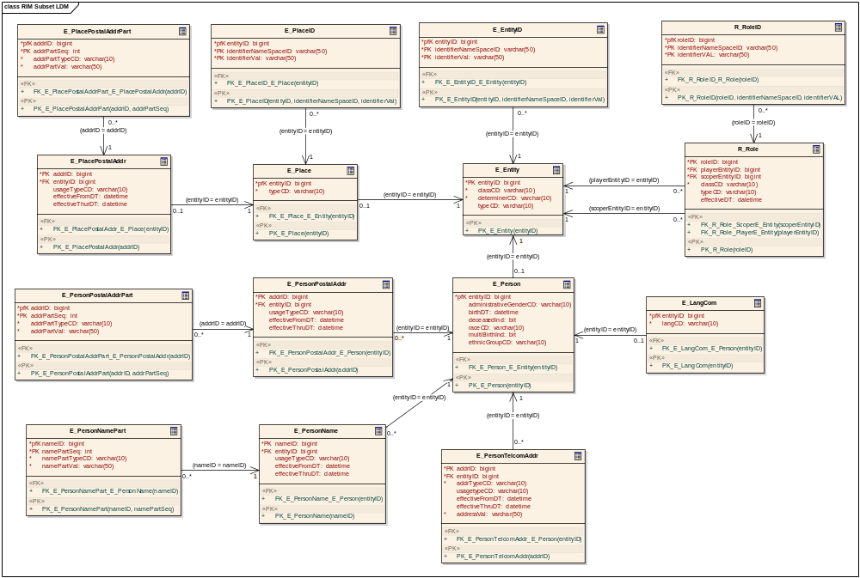
RIM Logical Data Model (Level 3)
March 2008
HL7 RIM-Based Database Design
<number> of 115

Slide 100
Database Design Modeling Steps
Select a Subset of RIM Model Elements
Resolve Inheritance Anomalies
Specialize Attribute Datatypes
Resolve Collection Datatypes
Resolve Complex Datatypes
Transform Classes into Tables
Define Data Integrity Rules
Assign Primary, Foreign, and Alternate Keys
Optimize the Database Design Model
Generate Database Definition Language
Document Departures from the RIM
March 2008
HL7 RIM-Based Database Design
<number> of 115

Slide 101
Optimize the Database Design Model
Inputs:
  Logical Data Model (Level 3)
  Data Integrity Rules
  Information Needs
Outputs:
  Physical Data Model (Level 1)
Process:
  Rename tables and columns to use problem domain specific nomenclature
  Use specialization tables to simplify enforcement of referential integrity rules
  Selectively promote attributes from dependent tables into their respective parent classes.
This step involves creation of a physical data model.
A goal of optimization is to create a model that is easier for SMEs to validate and for developers to understand.
Optimization includes reducing redundancy, ambiguity, optionality, and abstraction.
Access path analysis and performance hotspots should be carefully considered.
A balance should be struck between optimal performance and future-proofing
March 2008
HL7 RIM-Based Database Design
<number> of 115

Slide 102
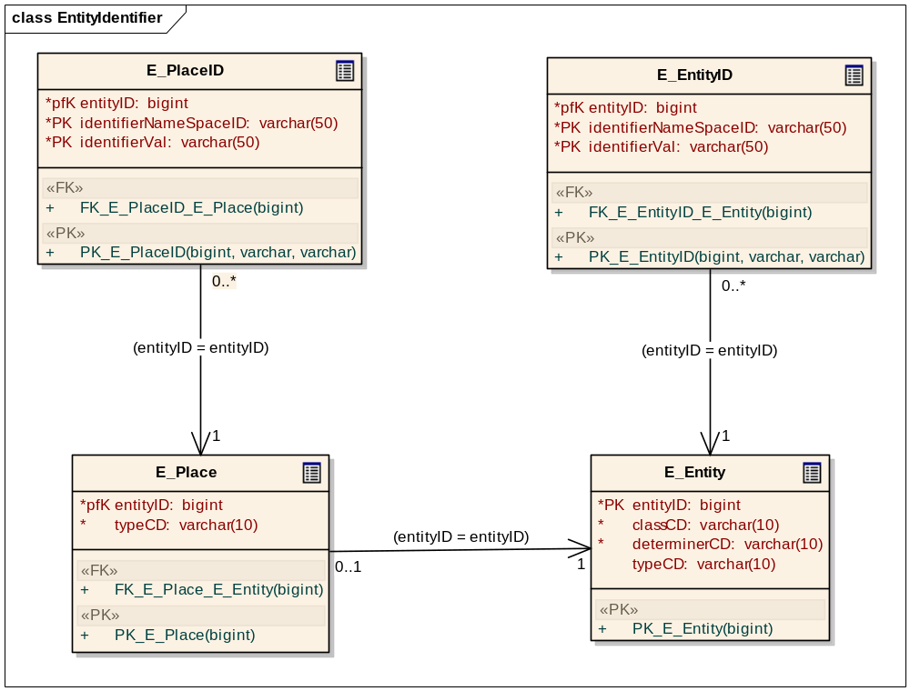
Eliminate Redundancy
March 2008
HL7 RIM-Based Database Design
<number> of 115

Slide 103
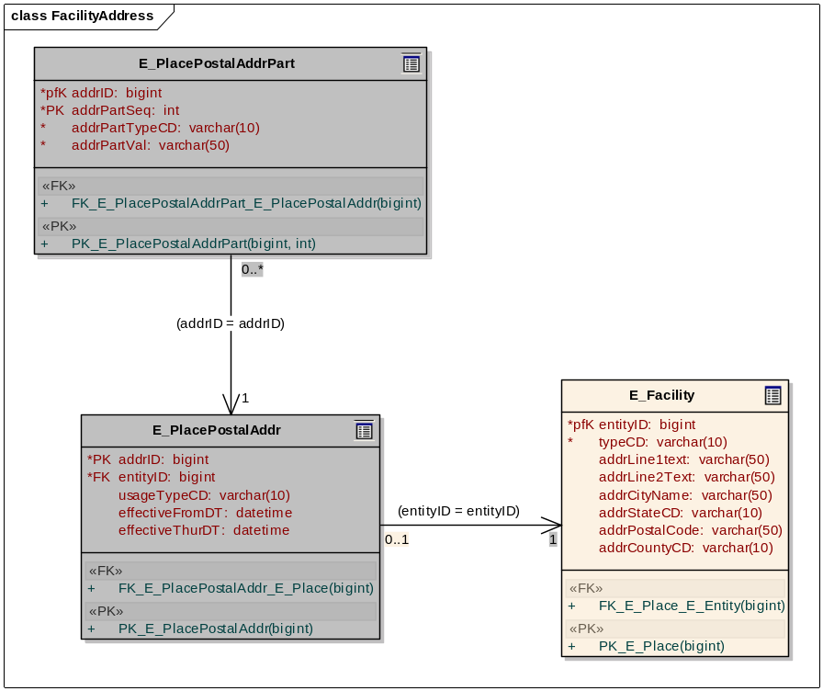
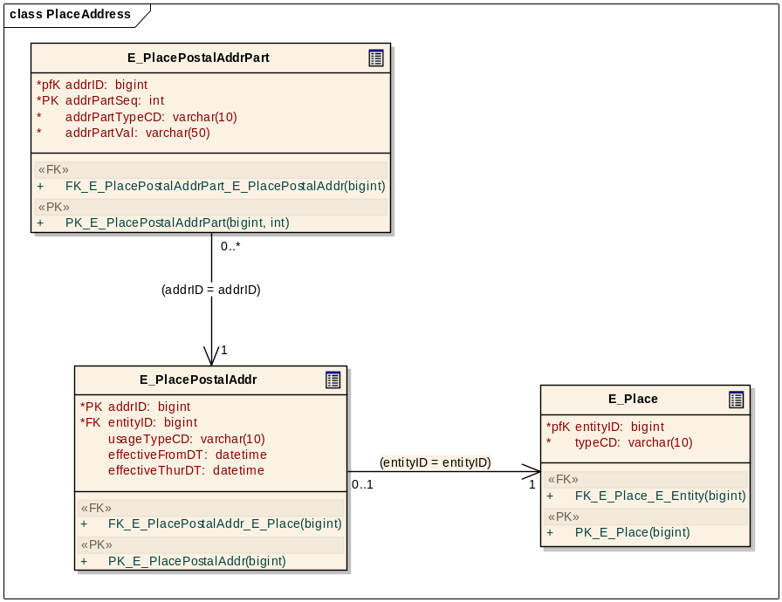
Reduce ambiguity and abstraction
March 2008
HL7 RIM-Based Database Design
<number> of 115

Slide 104
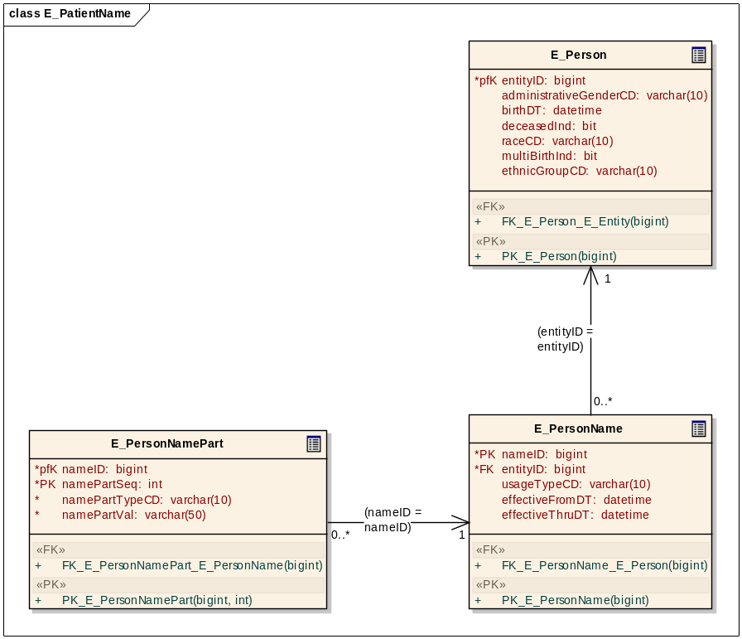
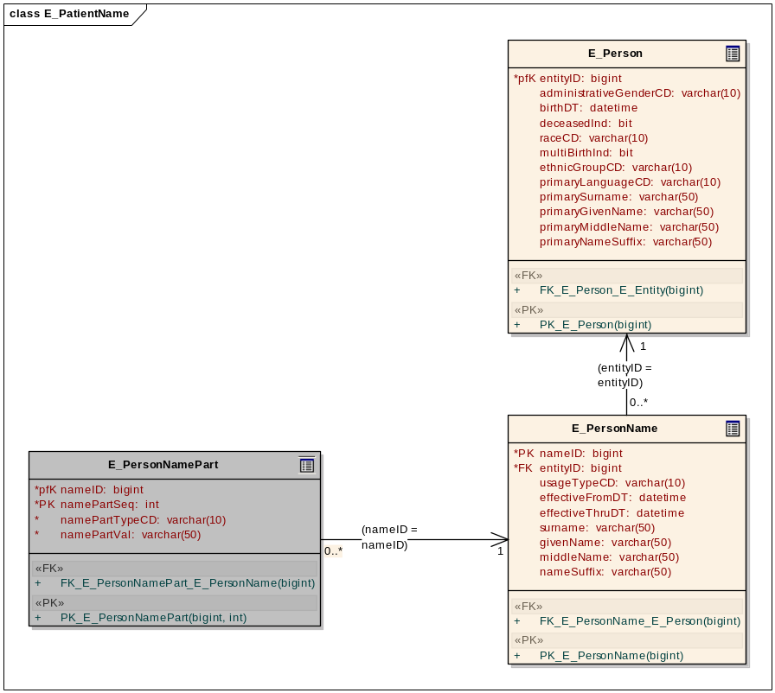
Optimal Performance and Future Proofing
March 2008
HL7 RIM-Based Database Design
<number> of 115

Slide 105
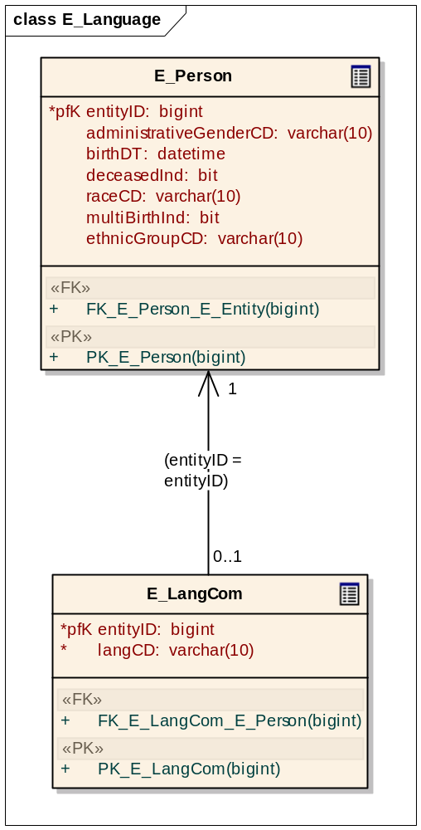
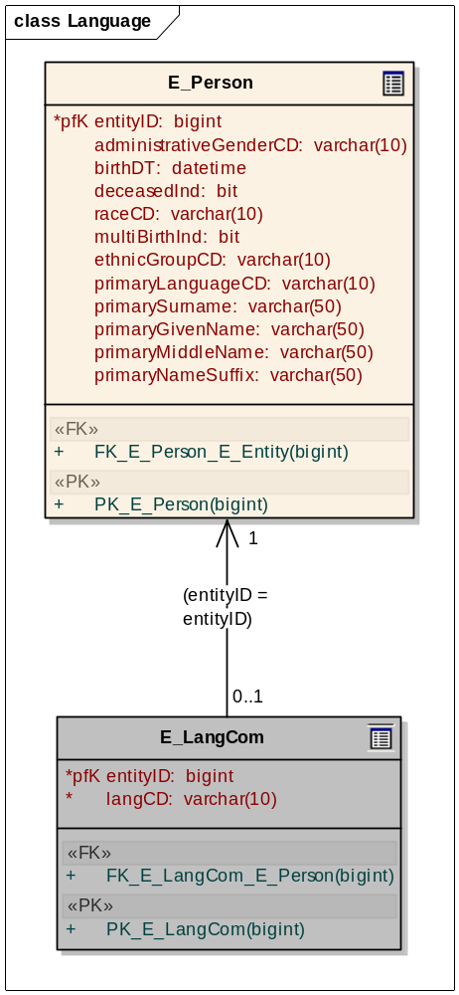
Structural Simplification
March 2008
HL7 RIM-Based Database Design
<number> of 115

Slide 106
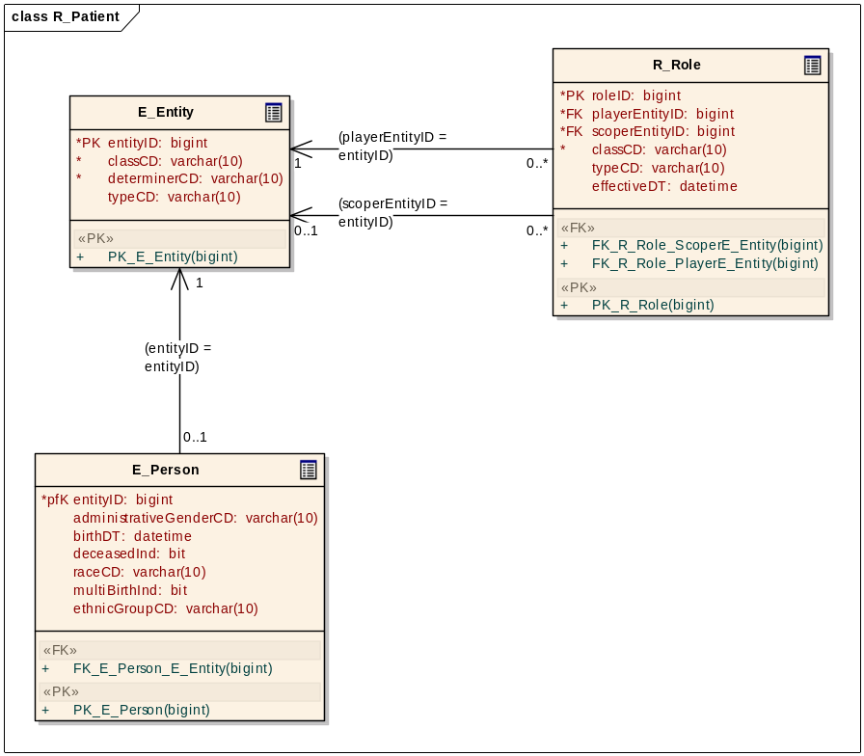
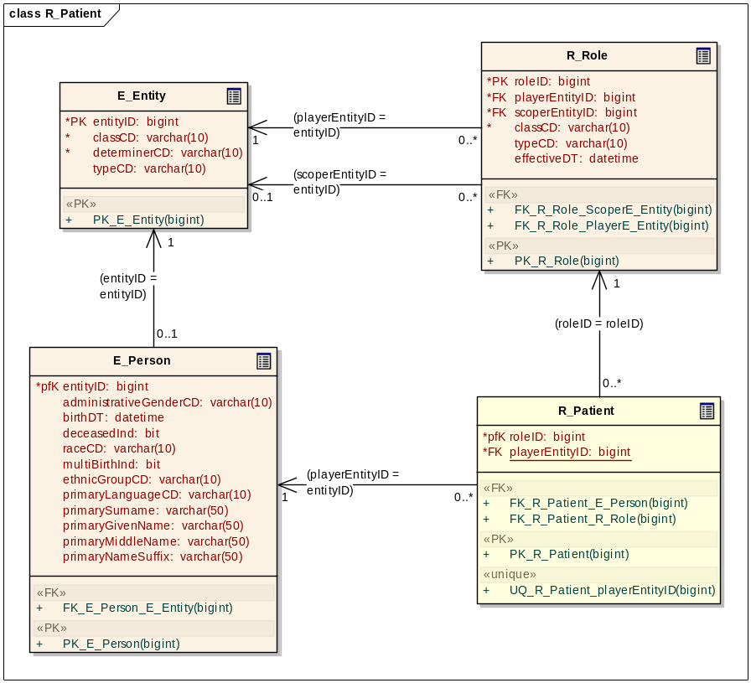
Simplify RI Enforcement
March 2008
HL7 RIM-Based Database Design
<number> of 115

Slide 107
Physical Data Model (Level 1)
E_PlacePostalAddrPart
E_PlaceID
E_EntityID
R_RoleID
*pfK
addrID: bigint
*pfK
entityID: bigint
*pfK
entityID: bigint
*pfK
roleID: bigint
*PK
addrPartSeq: int
*PK
identifierNameSpaceID: varchar(50)
*PK
identifierNameSpaceID: varchar(50)
*PK
identifierNameSpaceID: varchar(50)
*
addrPartTypeCD: varchar(10)
*PK
identifierVal: varchar(50)
*PK
identifierVal: varchar(50)
*PK
identifierVAL: varchar(50)
*
addrPartVal: varchar(50)
«FK»
«FK»
«FK»
«FK»
+
FK_E_PlaceID_E_Place(entityID)
+
FK_E_EntityID_E_Entity(entityID)
+
FK_R_RoleID_R_Role(roleID)
+
FK_E_PlacePostalAddrPart_E_PlacePostalAddr(addrID)
«PK»
«PK»
«PK»
«PK»
+
PK_E_PlaceID(entityID, identifierNameSpaceID, identifierVal)
+
PK_E_EntityID(entityID, identifierNameSpaceID, identifierVal)
+
PK_R_RoleID(roleID, identifierNameSpaceID, identifierVAL)
+
PK_E_PlacePostalAddrPart(addrID, addrPartSeq)
0..*
0..*
0..*
0..*
(entityID = entityID)
(roleID = roleID)
(addrID = addrID)
1
(entityID = entityID)
1
1
E_Facility
1
R_Role
E_PlacePostalAddr
*pfK
entityID: bigint
*PK
roleID: bigint
*
typeCD: varchar(10)
E_Entity
*FK
playerEntityID: bigint
*PK
addrID: bigint
addrLine1text: varchar(50)
*FK
scoperEntityID: bigint
*FK
entityID: bigint
addrLine2Text: varchar(50)
*PK
entityID: bigint
(playerEntityID = entityID)
*
classCD: varchar(10)
usageTypeCD: varchar(10)
addrCityName: varchar(50)
*
classCD: varchar(10)
1
0..*
typeCD: varchar(10)
effectiveFromDT: datetime
(entityID = entityID)
addrStateCD: varchar(10)
(entityID = entityID)
*
determinerCD: varchar(10)
effectiveDT: datetime
effectiveThurDT: datetime
addrPostalCode: varchar(50)
0..1
1
typeCD: varchar(10)
(scoperEntityID = entityID)
«FK»
0..1
1
addrCountyCD: varchar(10)
«PK»
0..1
0..*
«FK»
+
FK_E_PlacePostalAddr_E_Place(entityID)
«FK»
+
PK_E_Entity(entityID)
+
FK_R_Role_ScoperE_Entity(scoperEntityID)
«PK»
+
FK_E_Place_E_Entity(entityID)
1
+
FK_R_Role_PlayerE_Entity(playerEntityID)
+
PK_E_PlacePostalAddr(addrID)
«PK»
«PK»
+
PK_E_Place(entityID)
(entityID = entityID)
+
PK_R_Role(roleID)
0..1
1
(roleID = roleID)
E_PersonPostalAddr
E_Person
0..*
*PK
addrID: bigint
*pfK
entityID: bigint
R_Patient
*FK
entityID: bigint
administrativeGenderCD: varchar(10)
E_PersonPostalAddrPart
usageTypeCD: varchar(10)
birthDT: datetime
*pfK
roleID: bigint
effectiveFromDT: datetime
deceasedInd: bit
*FK
playerEntityID: bigint
*pfK
addrID: bigint
effectiveThruDT: datetime
raceCD: varchar(10)
*PK
addrPartSeq: int
addrLine1Text: bigint
multiBirthInd: bit
«FK»
*
addrPartTypeCD: varchar(10)
(addrID = addrID)
addrLine2Text: varchar(50)
(entityID = entityID)
ethnicGroupCD: varchar(10)
(playerEntityID = entityID)
+
FK_R_Patient_E_Person(playerEntityID)
*
addrPartVal: varchar(50)
0..*
1
addrCityName: varchar(50)
primaryLanguageCD: varchar(10)
1
0..*
+
FK_R_Patient_R_Role(roleID)
addrStateCD: varchar(10)
0..*
1
primarySurname: varchar(50)
«PK»
«FK»
addrPostalCode: varchar(50)
primaryGivenName: varchar(50)
+
PK_R_Patient(roleID)
+
FK_E_PersonPostalAddrPart_E_PersonPostalAddr(addrID)
addrCountryCD: varchar(10)
primaryMiddleName: varchar(50)
«PK»
primaryNameSuffix: varchar(50)
«unique»
+
PK_E_PersonPostalAddrPart(addrID, addrPartSeq)
«FK»
+
UQ_R_Patient_playerEntityID(playerEntityID)
+
FK_E_PersonPostalAddr_E_Person(entityID)
«FK»
«PK»
1
+
FK_E_Person_E_Entity(entityID)
1
+
PK_E_PersonPostalAddr(addrID)
«PK»
+
PK_E_Person(entityID)
(entityID = entityID)
1
(entityID = entityID)
(entityID = entityID)
E_PersonName
0..*
0..*
E_PersonNamePart
*PK
nameID: bigint
E_PersonTelcomAddr
0..1
*FK
entityID: bigint
*PK
addrID: bigint
*pfK
nameID: bigint
usageTypeCD: varchar(10)
*FK
entityID: bigint
E_LangCom
*PK
namePartSeq: int
effectiveFromDT: datetime
*
addrTypeCD: varchar(10)
*
namePartTypeCD: varchar(10)
effectiveThruDT: datetime
usagetypeCD: varchar(10)
*pfK
entityID: bigint
*
namePartVal: varchar(50)
(nameID = nameID)
surname: varchar(50)
effectiveFromDT: datetime
*
langCD: varchar(10)
0..*
1
givenName: varchar(50)
effectiveThruDT: datetime
«FK»
middleName: varchar(50)
*
addressVal: varchar(50)
«FK»
+
FK_E_PersonNamePart_E_PersonName(nameID)
nameSuffix: varchar(50)
+
FK_E_LangCom_E_Person(entityID)
«PK»
«FK»
«FK»
«PK»
+
PK_E_PersonNamePart(nameID, namePartSeq)
+
FK_E_PersonName_E_Person(entityID)
+
FK_E_PersonTelcomAddr_E_Person(entityID)
+
PK_E_LangCom(entityID)
«PK»
«PK»
+
PK_E_PersonName(nameID)
+
PK_E_PersonTelcomAddr(addrID)
March 2008
HL7 RIM-Based Database Design
<number> of 115

Slide 108
Database Design Modeling Steps
Select a Subset of RIM Model Elements
Resolve Inheritance Anomalies
Specialize Attribute Datatypes
Resolve Collection Datatypes
Resolve Complex Datatypes
Transform Classes into Tables
Define Data Integrity Rules
Assign Primary, Foreign, and Alternate Keys
Optimize the Database Design Model
Generate Database Definition Language
Document Departures from the RIM
March 2008
HL7 RIM-Based Database Design
<number> of 115

Slide 109

Generated DDL (PDM Level 2)
CREATE TABLE E_Person (
entityID bigint NOT NULL,
administrativeGenderCD varchar(10),
birthDT datetime,
deceasedInd bit,
raceCD varchar(10),
multiBirthInd bit,
ethnicGroupCD varchar(10),
primaryLanguageCD varchar(10),
primarySurname varchar(50),
primaryGivenName varchar(50),
primaryMiddleName varchar(50),
primaryNameSuffix varchar(50)
)
;
ALTER TABLE E_Person ADD CONSTRAINT PK_E_Person
PRIMARY KEY CLUSTERED (entityID)
;
ALTER TABLE E_Person ADD CONSTRAINT FK_E_Person_E_Entity
FOREIGN KEY (entityID) REFERENCES E_Entity (entityID)
;
March 2008
HL7 RIM-Based Database Design
<number> of 115

Slide 110
Database Design Modeling Steps
Select a Subset of RIM Model Elements
Resolve Inheritance Anomalies
Specialize Attribute Datatypes
Resolve Collection Datatypes
Resolve Complex Datatypes
Transform Classes into Tables
Define Data Integrity Rules
Assign Primary, Foreign, and Alternate Keys
Optimize the Database Design Model
Generate Database Definition Language
Document Departures from the RIM
March 2008
HL7 RIM-Based Database Design
<number> of 115

Slide 111
Departures from the RIM
Limited Place to a single address
Renamed Place to Facility
Limited Language Communication to Person only
Limited Person to a single Language Communication
Limited Observation Value to datatypes of BL and CD only.
Renamed Substance Administration to Vaccine Administration
March 2008
HL7 RIM-Based Database Design
<number> of 115

Slide 112
Database Design Modeling Steps
Select a Subset of RIM Model Elements
Resolve Inheritance Anomalies
Specialize Attribute Datatypes
Resolve Collection Datatypes
Resolve Complex Datatypes
Transform Classes into Tables
Define Data Integrity Rules
Assign Primary, Foreign, and Alternate Keys
Optimize the Database Design Model
Generate Database Definition Language
Document Departures from the RIM
SDM
LDM
PDM
March 2008
HL7 RIM-Based Database Design
<number> of 115

Slide 113

Questions / Discussion / Feedback
March 2008
HL7 RIM-Based Database Design
<number> of 115

Slide 114
Closing Thought
All models are wrong;
some are useful.
~ George Box
March 2008
HL7 RIM-Based Database Design
<number> of 115

Slide 115
Characteristics of a Useful Model
Salient: Since no model can represent everything, it must selectively represent those things most relevant to the task at hand.
Accurate: The model should precisely encode the actual state of affairs and not an erroneous or biased view.
Complete yet Parsimonious: The model should be as simple as possible, but no simpler. It should concisely capture all the relevant dimensions of the problem without squeezing out the opportunity for serendipitous or creative insight.
Perceptible: Models should be appropriately displayed in high fidelity as they won't be much use if we can't clearly see, hear, or feel them.
Understandable: Once we perceive the model we must be able to make sense of it; it mustn't be too complicated or unfamiliar for us to understand.
Descriptive: The model should clearly and objective describe the true situation.
Emotive: In addition, the model should convey a subjective feel for the emotional and value-laden connotations of the situation being modeled.
Inspiring: Because people are drawn to and inspired by thoughtful design, models should be elegant, i.e. they should synergistically combine style and substance.
Memorable: Models are not of much use if they pass quickly from the mind, or if they cannot be used as a mnemonic device. Models should be easily accessible for future reference and to refresh our understanding.
Flexible: As all models are, to some degree, inaccurate, irrelevant, mistaken, time-sensitive etc., they should be open to recursive revision to reflect new data, our growing understanding, or our evolving needs.
Coherent: Models do not exist in isolation but in interlocking systems, thus any particular model should be coherent with other related models.
Productive: Ultimately, the model has a purpose: the production of effective action. A good model should help define our goals and then specify the actions necessary to reach them.
Useful: Usefulness is the sum of the above properties and the degree to which they combine to promote understanding and effective action. It is important to note that the most accurate, or the most complete, or the most elegant model is not necessarily the most useful. All models are incomplete. All models a compromise. The model maker's art lies in making those shrewd trade-offs that will render the model most useful to the problem at hand.
March 2008
HL7 RIM-Based Database Design
<number> of 115

Slide 116
Thank You
Abdul-Malik Shakir
Principal Consultant
Shakir Consulting
1407 Foothill Blvd., Suite 145
La Verne, CA 91750
Office: (909) 596-6790 Mobile: (626) 644-4491
Email: AbdulMalik@ShakirConsulting.com
March 2008
HL7 RIM-Based Database Design
<number> of 115

